Slide 1
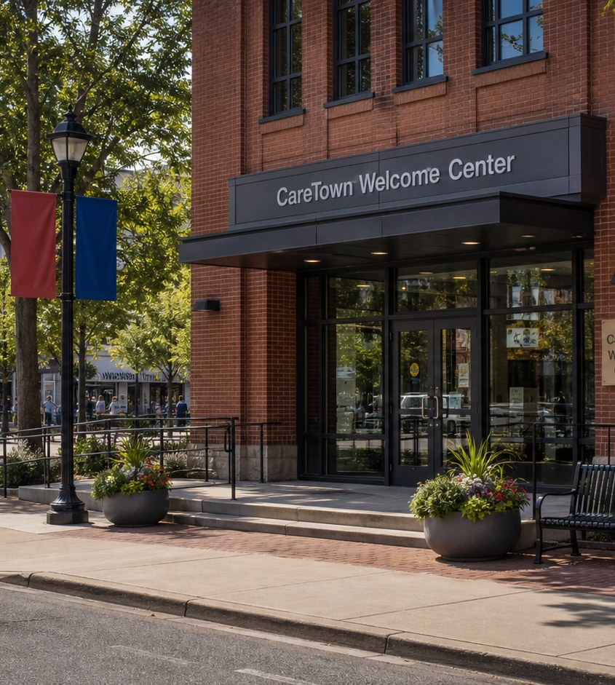
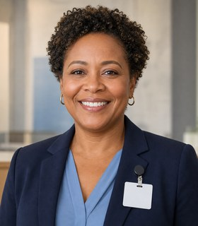

Welcome module · Start here
Welcome to CareTown
Two class periods. Meet the map. Choose a start.
Naomi + Grace
01

Slide 2
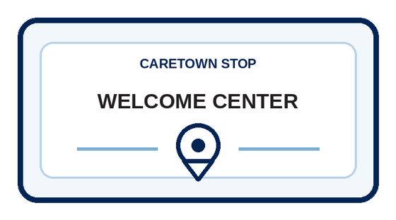
Why we start here
You do not have to choose your whole future today.
You are here to explore. A good question is a good place to begin.
CareTown · Welcome module · Welcome Center
02

Slide 3
Welcome agenda
Two class periods. Then any stop.
Period 1
Period 2
Then
Welcome to CareTown
Choosing your first stop
Eight pathway stops
W0.1 · W0.2
W0.3 · W0.4
Exit ticket
W0.5 · W0.6
W0.7
Exit ticket
Modules 1-8
Any order
CareTown · Welcome module · Welcome Center
03

Slide 4
Unit 1 of 2 · 50-minute class period
8 min
W0.1 Welcome to CareTown
Welcome to CareTown
7 min
W0.2 60-Second Brainstorm
12 min
W0.3 CareTown Pathway Menu
18 min
W0.4 CareTown Team Map
5 min
Exit ticket
CareTown · Welcome module · Welcome Center · Unit 1
04

Slide 5
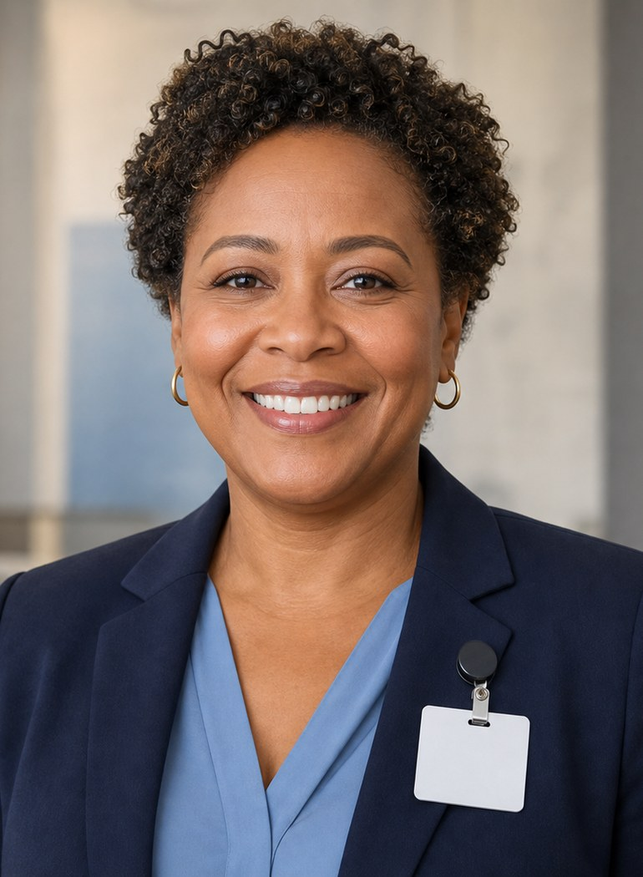
Welcome Center guide
Meet Naomi Price.
Career pathways coordinator
You do not have to choose today.
Questions come before decisions.
A first stop is not a final answer.
CareTown · Welcome module · Welcome Center · Unit 1
05

Slide 6

Student explorer
Meet Grace Kim.
CareTown Explorer
What does each pathway do?
Which stop should I visit first?
It is okay to be unsure.
CareTown · Welcome module · Welcome Center · Unit 1
06

Slide 7

Video · about 2 minutes · part of W0.1
Watch the Welcome to CareTown video
Meet the Welcome Center and the CareTown map.
As you watch
One stop you want to visit. One question you have.
CareTown · Welcome module · Welcome Center · Unit 1
07

Slide 8

Activity
W0.1 Welcome to CareTown
8 min
Whole class
Workbook p. 9
1
Watch the Welcome to CareTown video.
2
Name what is fictional and what is real.
3
Write one question you hope to answer.
Done when: One question is written in the W0.1 space.
CareTown · Welcome module · Welcome Center · Unit 1
08

Slide 9

Activity
W0.2 60-Second Brainstorm
7 min
Individual, timed
Workbook p. 12
1
Round 1: list ice cream flavors.
2
Round 2: list healthcare occupations.
3
Star one you know least about.
Done when: Both lists are written and one job is starred.
CareTown · Welcome module · Welcome Center · Unit 1
09

Slide 10
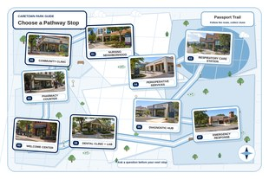
Activity
W0.3 CareTown Pathway Menu
12 min
Class or partners
Workbook p. 14
1
Read the eight CareTown stops.
2
Check the roles you have heard of.
3
Name one role that surprised you.
Done when: The roles inventory is checked and one surprise is named.
CareTown · Welcome module · Welcome Center · Unit 1
10

Slide 11
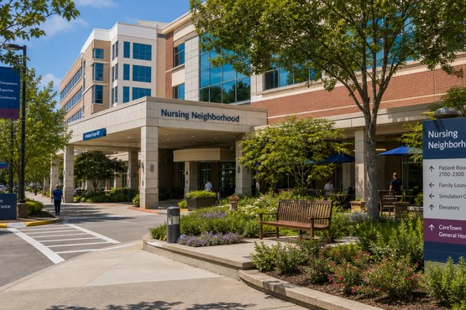
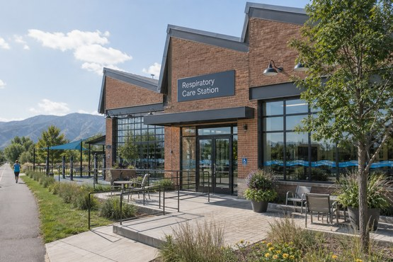
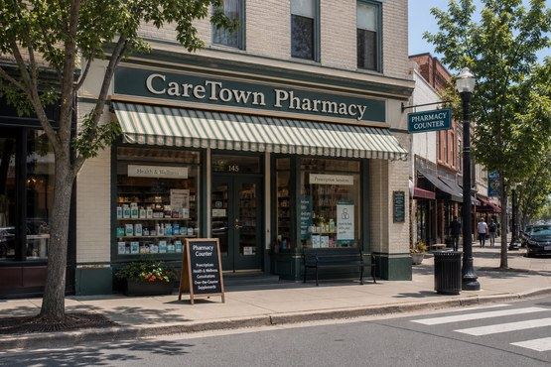
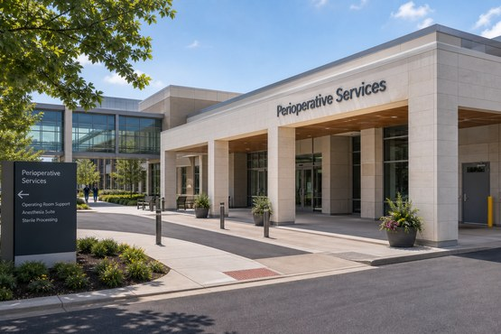
Pathway previews · Stops 1-4
Which stop makes you curious?
Module 1
Module 2
Module 3
Module 4
Nursing Neighborhood
Respiratory Care Station
Pharmacy Counter
Perioperative Services
Help patients directly
Breathing and equipment
Details and accuracy
Careful readiness
CareTown · Welcome module · Welcome Center · Unit 1
11

Slide 12
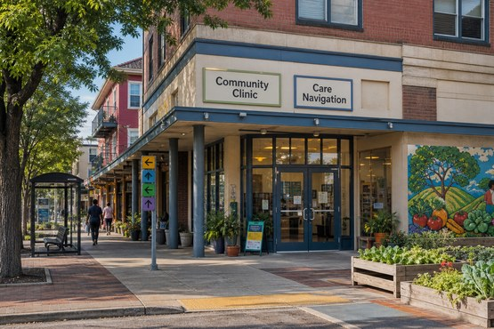
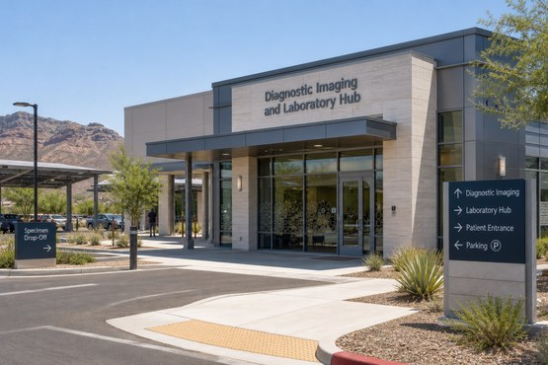
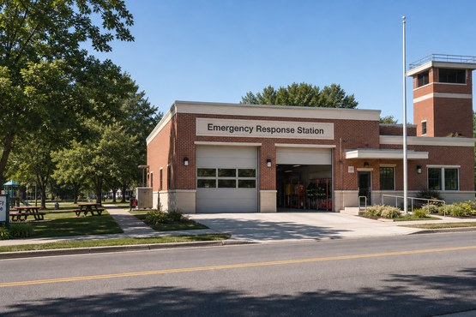
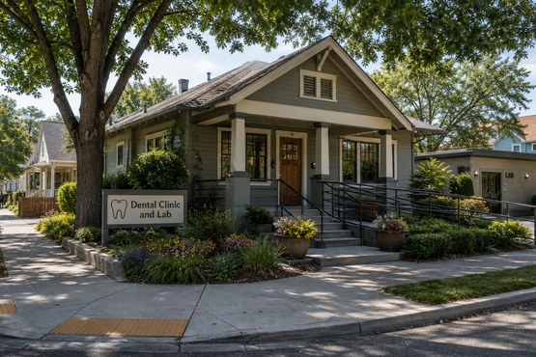
Pathway previews · Stops 5-8
Which stop makes you curious?
Module 5
Module 6
Module 7
Module 8
Community Clinic
Diagnostic Hub
Emergency Response Station
Dental Clinic and Lab
Help people get care
Images and lab work
Calm under pressure
Hands-on patient comfort
CareTown · Welcome module · Welcome Center · Unit 1
12

Slide 13
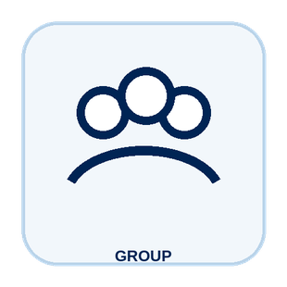
Activity
W0.4 CareTown Team Map
18 min
Solo, pairs, or groups
Workbook p. 17
1
Listen to the patient story.
2
Place each role in a map zone.
3
Draw one arrow between two roles.
Done when: Every word-bank role is placed in a zone.
CareTown · Welcome module · Welcome Center · Unit 1
13

Slide 14
Check for understanding
In CareTown, what is a "stop"?
1
One pathway module
2
A test
3
A job offer
Show 1, 2, or 3 fingers. Then explain why.
CareTown · Welcome module · Welcome Center · Unit 1
14

Slide 15
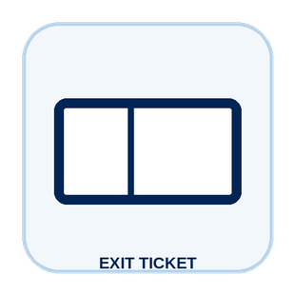
Unit 1 exit ticket
Before you go
5 min
Workbook p. 31
1
Two pathways I want to learn more about.
2
One question I have about each pathway.
CareTown · Welcome module · Welcome Center · Unit 1
15

Slide 16
Unit 2 of 2 · 50-minute class period
6 min
Look back at the Team Map
Choosing Your First Stop
15 min
W0.5 Interest and Strengths Check
12 min
W0.6 What Matters to Me
12 min
W0.7 My Starting Interests
5 min
Exit ticket
CareTown · Welcome module · Welcome Center · Unit 2
16

Slide 17

Recap
Look back at your Team Map.
Which role surprised you most?
Today: choose where to start.
CareTown · Welcome module · Welcome Center · Unit 2
17

Slide 18

Activity
W0.5 Interest and Strengths Check
15 min
Individual
Workbook p. 26
1
Check what you may enjoy.
2
Check what you may be good at.
3
Answer the reflection questions.
Done when: Boxes are checked and the questions are answered.
CareTown · Welcome module · Welcome Center · Unit 2
18

Slide 19

Activity
W0.6 What Matters to Me
12 min
Solo, pairs, or groups
Workbook p. 28
1
Mark each factor in one of three groups.
2
Circle your top two factors.
3
Keep it private if you like.
Done when: Every factor is marked in one group.
CareTown · Welcome module · Welcome Center · Unit 2
19

Slide 20

Activity
W0.7 My Starting Interests
12 min
Individual
Workbook p. 29
1
List stops or careers that interest you.
2
Add why each one interests you now.
3
Name your first stop and one question.
Done when: Your starting interests and first stop are written.
CareTown · Welcome module · Welcome Center · Unit 2
20

Slide 21
Check for understanding
Choosing a first stop means...
1
Choosing your career forever
2
Picking where to explore first
3
Skipping the other stops
Show 1, 2, or 3 fingers. Then explain why.
CareTown · Welcome module · Welcome Center · Unit 2
21

Slide 22
Unit 2 exit ticket
Before you go
5 min
Workbook p. 31
1
The next CareTown stop I will visit, and why.
2
The question I will bring to that stop.
CareTown · Welcome module · Welcome Center · Unit 2
22

Slide 23

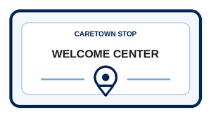
Next stop
Explore before you decide.
Visit the eight stops in any order. Your first stop is not your final answer.
CareTown · Welcome module · Welcome Center · Unit 2
23

