Slide 1
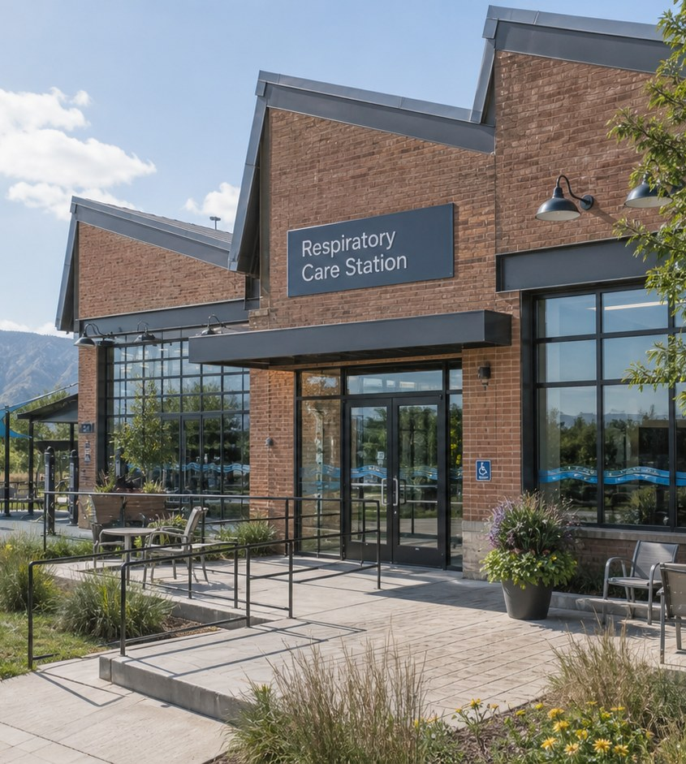
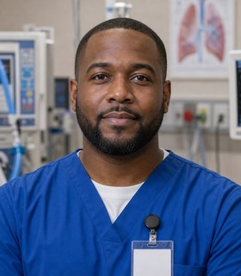

Module 2 · Respiratory Care Pathway
Respiratory Care Station
Four class periods: the team, training, the workweek, and fit.
Darius + Leo
01

Slide 2
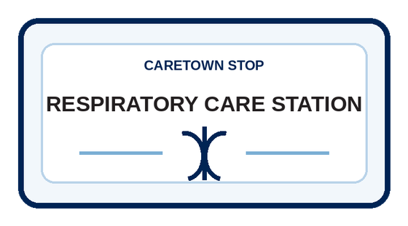
Stop question
How does calm science become clear support for breathing?
Collect clues in every unit. We answer it together in Unit 4.
CareTown · Module 2 · Respiratory Care Station
02

Slide 3
Stop agenda
Four class periods. One stop.
Period 1
Period 2
Period 3
Period 4
Meet the team
Training week
The workweek
Fit and next steps
R1.1
Exit ticket
R2.1
Exit ticket
R3.1
R3.2
R3.3
Exit ticket
R4.1
R4.2
R4.3
Exit ticket
CareTown · Module 2 · Respiratory Care Station
03

Slide 4
Unit 1 of 4 · 50-minute class period
5 min
Meet Darius and Leo
Map Respiratory Care Across the Team
15 min
Guide cards, snapshot, quick guide
25 min
R1.1 Respiratory Care Team Map
5 min
Exit ticket
CareTown · Module 2 · Respiratory Care Station · Unit 1
04

Slide 5

Opener · about 5 minutes
Meet Darius and Leo
Start on the Respiratory Care Station webpage.
As you meet them
One thing Darius does. One question Leo has.
CareTown · Module 2 · Respiratory Care Station · Unit 1
05

Slide 6
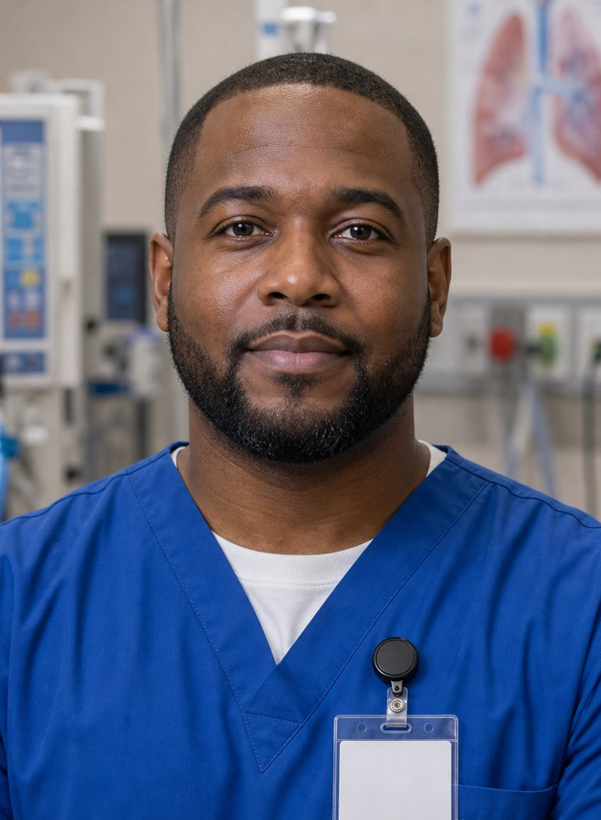
Meet the professional guide
Meet Darius Owens.
Respiratory therapist
I prepare before I enter.
I use exact words and observations.
I leave the next person ready.
CareTown · Module 2 · Respiratory Care Station · Unit 1
06

Slide 7

Meet the student explorer
Meet Leo Martinez.
Respiratory therapy student
What does an RT student week include?
Which steps come after graduation?
Could this fit my life right now?
CareTown · Module 2 · Respiratory Care Station · Unit 1
07

Slide 8
Pathway snapshot
Respiratory therapists at a glance
What they do
Where they work
Median pay
Job growth
Care for patients who have trouble breathing
Mostly hospitals; also clinics and home care
$82,280
9%
U.S., May 2025
2025-35, much faster than average
Source: U.S. Bureau of Labor Statistics, Occupational Outlook Handbook, Respiratory Therapists, www.bls.gov/ooh/healthcare/respiratory-therapists.htm (accessed Oct 9, 2026).
CareTown · Module 2 · Respiratory Care Station · Unit 1
08

Slide 9
Roles quick guide
RT, RRT, and RCP are not the same term.
RT
RRT
RCP
Respiratory therapist: the role or common job title.
Registered Respiratory Therapist: a national credential.
Respiratory Care Practitioner: California's license title.
CareTown characters are fictional. The job titles are real.
CareTown · Module 2 · Respiratory Care Station · Unit 1
09

Slide 10

Activity
R1.1 Respiratory Care Team Map
25 min
Solo, pairs, or groups
Workbook p. 66
1
Add at least four settings.
2
Connect team roles with arrows.
3
Label one information need.
Done when: Four roles are connected and one need is labeled.
CareTown · Module 2 · Respiratory Care Station · Unit 1
10

Slide 11
Check for understanding
What is California's license title for respiratory therapists?
1
RRT
2
RCP
3
RT
Show 1, 2, or 3 fingers. Then explain why.
CareTown · Module 2 · Respiratory Care Station · Unit 1
11

Slide 12
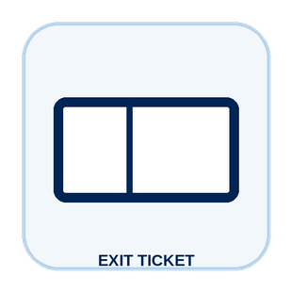
Unit 1 exit ticket
Before you go
5 min
Workbook p. 84
1
Two roles I learned about in this unit.
2
One task or piece of information that moves between them.
CareTown · Module 2 · Respiratory Care Station · Unit 1
12

Slide 13
Unit 2 of 4 · 50-minute class period
5 min
Recap: one role from Unit 1
Build Leo's Respiratory Therapy Training Week
10 min
Training route and sample week
30 min
R2.1 Build Leo's Week and Route
5 min
Exit ticket
CareTown · Module 2 · Respiratory Care Station · Unit 2
13

Slide 14

Recap
Name one role from Unit 1.
Today: Leo's training week.
Say the role and one thing it does.
CareTown · Module 2 · Respiratory Care Station · Unit 2
14

Slide 15
Training route and sample week
A sample week needs more than class time.
Mon
Tue
Wed
Thu
Fri
Weekend
science class
skills lab
study
clinical + travel
feedback
rest + review
Example only. Ask each program for its current schedule.
CareTown · Module 2 · Respiratory Care Station · Unit 2
15

Slide 16
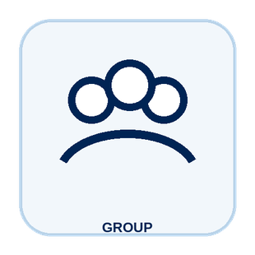
Activity
R2.1 Build Leo's Week and Route
30 min
Solo, pairs, or groups
Workbook p. 68
1
Place class, lab, and clinical.
2
Add study, travel, meals, and rest.
3
Write one program question.
Done when: Your week and route show one program question.
CareTown · Module 2 · Respiratory Care Station · Unit 2
16

Slide 17
Check for understanding
Leo's program includes clinical days. What should he plan around?
1
Clinical travel, study, and rest
2
Only class hours
3
Nothing until graduation
Show 1, 2, or 3 fingers. Then explain why.
CareTown · Module 2 · Respiratory Care Station · Unit 2
17

Slide 18
Unit 2 exit ticket
Before you go
5 min
Workbook p. 84
1
One question I would ask a respiratory therapy program before applying.
2
One support that could help a student in this training.
CareTown · Module 2 · Respiratory Care Station · Unit 2
18

Slide 19
Unit 3 of 4 · 50-minute class period
2 min
Recap: one week question
Move Breathing-Support Information Clearly
15 min
R3.1 Podcast Keyword Catcher
14 min
R3.2 Darius's Respiratory Care Shift
14 min
R3.3 Breathing-Support Team Huddle
5 min
Exit ticket
CareTown · Module 2 · Respiratory Care Station · Unit 3
19

Slide 20
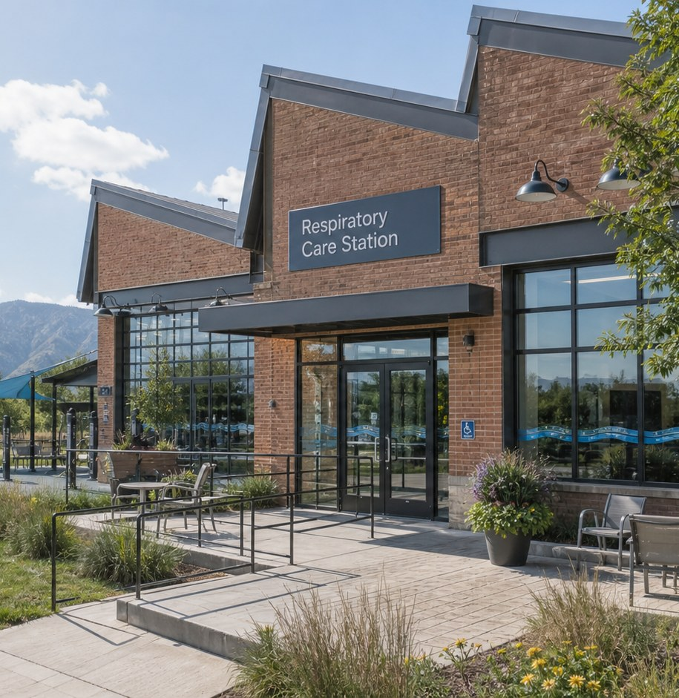
Recap, then the case
One change in breathing connects many workers.
An adult tells the team, "Breathing feels harder than it did this morning."
First: one question from the training week.
CareTown · Module 2 · Respiratory Care Station · Unit 3
20

Slide 21

Activity
R3.1 Podcast Keyword Catcher
15 min
Listen, then share
Workbook p. 71
1
Listen or follow the transcript.
2
Record four keywords.
3
Explain one connection.
Done when: Four keywords and one connection are written.
CareTown · Module 2 · Respiratory Care Station · Unit 3
21

Slide 22

Activity
R3.2 Darius's Respiratory Care Shift
14 min
Class vote or pairs
Workbook p. 72
1
Read each fictional moment.
2
Choose what keeps the shift clear.
3
Give a reason for each choice.
Done when: Every choice has an answer and a reason.
CareTown · Module 2 · Respiratory Care Station · Unit 3
22

Slide 23
Safe communication pattern
Exact words beat a guessed cause.
Context
Facts
Need
Where are we, and what changed?
What exact words or details were shared?
Which qualified role should hear it?
CareTown · Module 2 · Respiratory Care Station · Unit 3
23

Slide 24
Activity
R3.3 Breathing-Support Team Huddle
14 min
Solo, then compare
Workbook p. 77
1
Name the setting and what changed.
2
Use exact words or details.
3
Name who should receive it.
Done when: Your update names context, facts, and a next role.
CareTown · Module 2 · Respiratory Care Station · Unit 3
24

Slide 25
Check for understanding
A patient says breathing feels harder. What is the best update?
1
A guessed cause
2
Exact words, to the right role
3
Wait until shift end
Show 1, 2, or 3 fingers. Then explain why.
CareTown · Module 2 · Respiratory Care Station · Unit 3
25

Slide 26
Unit 3 exit ticket
Before you go
5 min
Workbook p. 85
1
One exact fact a respiratory therapist must get right.
2
The person or role who should receive that fact.
CareTown · Module 2 · Respiratory Care Station · Unit 3
26

Slide 27
Unit 4 of 4 · 50-minute class period
3 min
Recap: one clue
Respiratory Care Fit Check and Next Steps
15 min
R4.1 Strengths and Fit Check
10 min
R4.2 Practical Factor Check
17 min
R4.3 Career Passport and Next-Step Planner
5 min
Exit ticket
CareTown · Module 2 · Respiratory Care Station · Unit 4
27

Slide 28
Recap: name one clue from this stop
Meaningful does not mean easy.
Why people choose it
What can be hard
Calm science
Nights and long shifts
Clear support
Physical work
Team connection
Urgent moments
CareTown · Module 2 · Respiratory Care Station · Unit 4
28

Slide 29

Activity
R4.1 Respiratory Care Strengths and Fit Check
15 min
Individual · share optional
Workbook p. 79
1
Check strengths that fit.
2
Name one skill to build.
3
Choose yes, maybe, or not right now.
Done when: Three strengths, two lines, and a reasoned fit answer.
CareTown · Module 2 · Respiratory Care Station · Unit 4
29

Slide 30

Activity
R4.2 Practical Factor Check
10 min
Individual · may stay private
Workbook p. 81
1
Mark every practical factor.
2
Name one factor to learn about.
3
Name one person or place to ask.
Done when: Every row is marked; one factor and one source are named.
CareTown · Module 2 · Respiratory Care Station · Unit 4
30

Slide 31

Activity
R4.3 Career Passport and Next-Step Planner
17 min
Individual writing
Workbook p. 82
1
Write one fact to verify.
2
Choose one next step.
3
Name one trusted person or source.
Done when: One fact, one next step, and one source are written.
CareTown · Module 2 · Respiratory Care Station · Unit 4
31

Slide 32
Unit 4 exit ticket
Before you go
5 min
Workbook p. 85
1
One action I will take next, and how it connects to my R4.1 fit answer.
2
One trusted source I will use.
CareTown · Module 2 · Respiratory Care Station · Unit 4
32

Slide 33
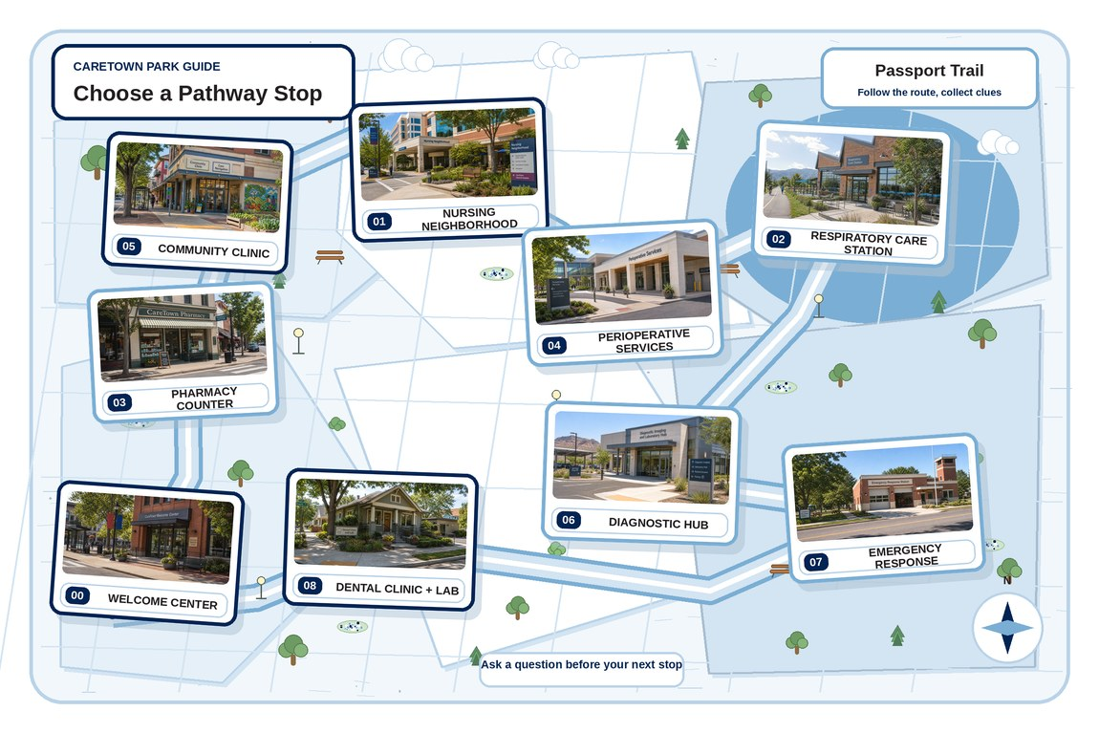
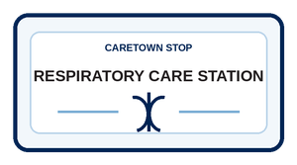
Next stop
Calm science becomes clear support through a team.
Keep exploring Respiratory Care, compare it with another stop, or choose a new one.
CareTown · Module 2 · Respiratory Care Station · Unit 4
33

