Slide 1
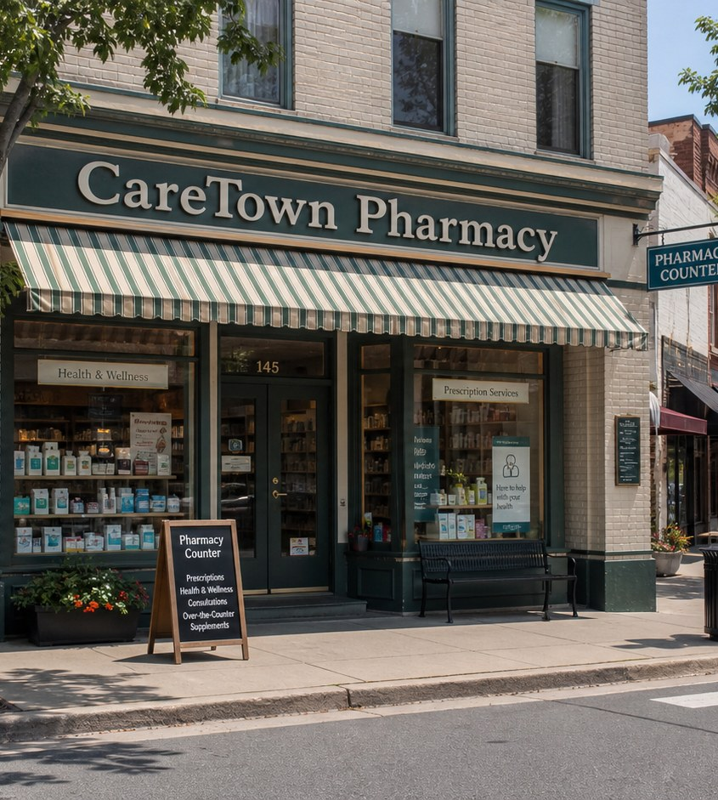


Module 3 · Pharmacy Pathway
Pharmacy Counter
Four class periods: the team, training, the workweek, and fit.
Priya + Sofia
01

Slide 2
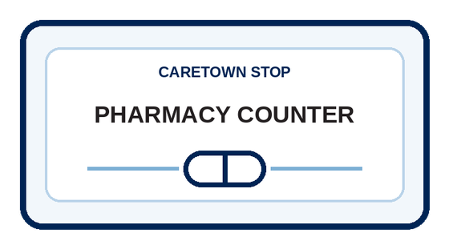
Stop question
What has to be accurate before anything reaches the counter?
Collect clues in every unit. We answer it together in Unit 4.
CareTown · Module 3 · Pharmacy Counter
02

Slide 3
Stop agenda
Four class periods. One stop.
Period 1
Period 2
Period 3
Period 4
Meet the team
Training week
The workweek
Fit and next steps
P1.1
Exit ticket
P2.1
Exit ticket
P3.1
P3.2
P3.3
Exit ticket
P4.1
P4.2
P4.3
Exit ticket
CareTown · Module 3 · Pharmacy Counter
03

Slide 4
Unit 1 of 4 · 50-minute class period
5 min
Meet Priya and Sofia
Enter the Pharmacy Pathway
15 min
Guide cards, snapshot, quick guide
25 min
P1.1 Pharmacy Workflow and Role Sort
5 min
Exit ticket
CareTown · Module 3 · Pharmacy Counter · Unit 1
04

Slide 5

Opener · about 5 minutes
Meet Priya and Sofia
Start on the Pharmacy Counter webpage.
As you meet them
One thing Priya does. One question Sofia has.
CareTown · Module 3 · Pharmacy Counter · Unit 1
05

Slide 6

Meet the professional guide
Meet Priya Shah.
Pharmacy technician
I compare what I see with the record.
I pause when something does not match.
I bring questions to the pharmacist.
CareTown · Module 3 · Pharmacy Counter · Unit 1
06

Slide 7

Meet the student explorer
Meet Sofia Nguyen.
Pharmacy technician student
What does a technician actually do?
How do I speak up when I am unsure?
Could this fit my life right now?
CareTown · Module 3 · Pharmacy Counter · Unit 1
07

Slide 8
Pathway snapshot
Pharmacy technicians at a glance
What they do
Where they work
Median pay
Job growth
Help pharmacists dispense prescription medication
Pharmacies, stores, and hospitals
$45,750
6%
U.S., May 2025
2025-35, faster than average
Source: U.S. Bureau of Labor Statistics, Occupational Outlook Handbook, Pharmacy Technicians, www.bls.gov/ooh/healthcare/pharmacy-technicians.htm (accessed Oct 9, 2026).
CareTown · Module 3 · Pharmacy Counter · Unit 1
08

Slide 9
Roles quick guide
Pharmacy is a team.
Pharmacy technician
Pharmacist
Clerk or aide
Counts, packages, labels, and keeps records under a pharmacist.
Checks prescriptions and answers every medicine question.
Helps with customers, phones, and stocking as allowed.
CareTown characters are fictional. The job titles are real.
CareTown · Module 3 · Pharmacy Counter · Unit 1
09

Slide 10

Activity
P1.1 Pharmacy Workflow and Role Sort
25 min
Solo, pairs, or groups
Workbook p. 93
1
Number the five workflow steps.
2
Sort each task card into a group.
3
Unsure? Use: ask the pharmacist.
Done when: Every card is placed and one handoff is marked.
CareTown · Module 3 · Pharmacy Counter · Unit 1
10

Slide 11
Check for understanding
A customer asks, "What does this medicine do?" Who answers?
1
Pharmacy technician
2
Pharmacist
3
Clerk or aide
Show 1, 2, or 3 fingers. Then explain why.
CareTown · Module 3 · Pharmacy Counter · Unit 1
11

Slide 12
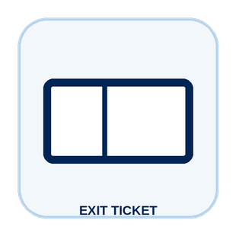
Unit 1 exit ticket
Before you go
5 min
Workbook p. 108
1
Two roles I learned about in this unit.
2
One task or piece of information that moves between them.
CareTown · Module 3 · Pharmacy Counter · Unit 1
12

Slide 13
Unit 2 of 4 · 50-minute class period
5 min
Recap: one role from Unit 1
Week in the Life of a Pharmacy Technician Student
10 min
Training route and sample week
30 min
P2.1 Build Sofia's Training Week
5 min
Exit ticket
CareTown · Module 3 · Pharmacy Counter · Unit 2
13

Slide 14

Recap
Name one role from Unit 1.
Today: Sofia's training week.
Say the role and one thing it does.
CareTown · Module 3 · Pharmacy Counter · Unit 2
14

Slide 15
Training route and sample week
A sample week needs more than class time.
Mon
Tue
Wed
Thu
Fri
Weekend
class
lab
class + study
terms practice
externship
rest + review
Example only. Ask each program for its current schedule.
CareTown · Module 3 · Pharmacy Counter · Unit 2
15

Slide 16

Activity
P2.1 Build Sofia's Training Week
30 min
Solo, pairs, or groups
Workbook p. 95
1
Place class, lab, and externship first.
2
Add travel, meals, study, and rest.
3
Mark one full day and one support.
Done when: Your week shows a pressure point, support, and question.
CareTown · Module 3 · Pharmacy Counter · Unit 2
16

Slide 17
Check for understanding
Which belongs in a realistic training week for Sofia?
1
Class only
2
Externship only
3
Class, lab, externship, study, rest
Show 1, 2, or 3 fingers. Then explain why.
CareTown · Module 3 · Pharmacy Counter · Unit 2
17

Slide 18
Unit 2 exit ticket
Before you go
5 min
Workbook p. 108
1
One question I would ask a pharmacy technician program before applying.
2
One support that could help a student in this training.
CareTown · Module 3 · Pharmacy Counter · Unit 2
18

Slide 19
Unit 3 of 4 · 50-minute class period
2 min
Recap: one week question
Week in the Life of Pharmacy Technician Work
15 min
P3.1 Podcast Keyword Catcher
14 min
P3.2 Priya's Accuracy Check
14 min
P3.3 Pause, Check, Clarify Huddle
5 min
Exit ticket
CareTown · Module 3 · Pharmacy Counter · Unit 3
19

Slide 20
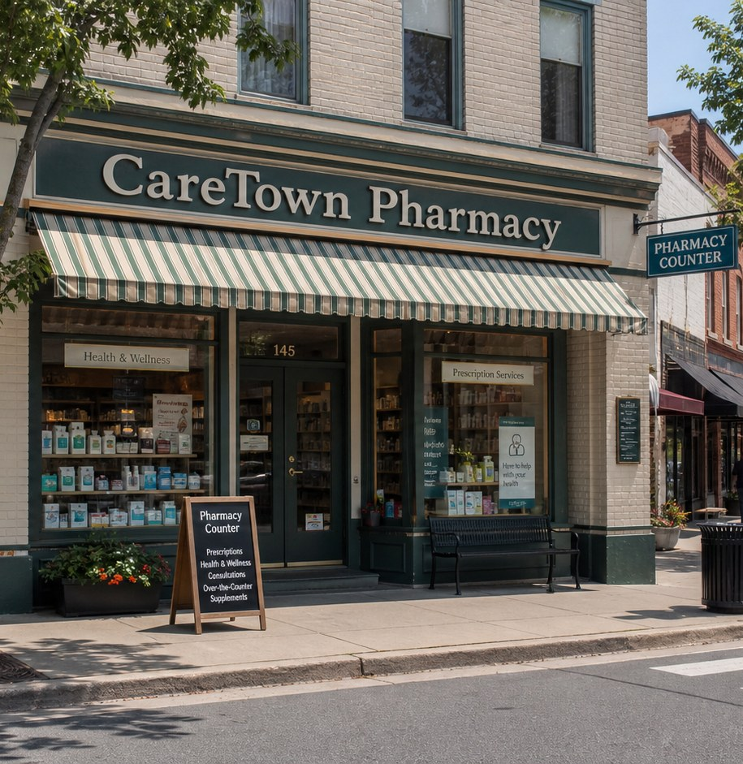
Recap, then the case
One detail does not match.
An order arrives. Priya compares it with the record. One identifier is different.
First: one question from the training week.
CareTown · Module 3 · Pharmacy Counter · Unit 3
20

Slide 21

Activity
P3.1 Podcast Keyword Catcher
15 min
Listen as a class
Workbook p. 97
1
Listen or read along.
2
Write three to five keywords.
3
Write one question to ask.
Done when: Three keywords, one idea, and one question are written.
CareTown · Module 3 · Pharmacy Counter · Unit 3
21

Slide 22

Activity
P3.2 Priya's Accuracy Check
14 min
Class vote or pairs
Workbook p. 98
1
Read each fictional moment.
2
Choose the strongest next move.
3
Name what Priya protects.
Done when: Every choice has an answer and a reason.
CareTown · Module 3 · Pharmacy Counter · Unit 3
22

Slide 23
Safe communication pattern
Notice, pause, and ask the right person.
Notice
Pause
Clarify
Compare the exact words and records.
Hold the step that depends on the answer.
Bring the question to the pharmacist.
CareTown · Module 3 · Pharmacy Counter · Unit 3
23

Slide 24
Activity
P3.3 Pause, Check, Clarify Huddle
14 min
Solo, then compare
Workbook p. 101
1
Write the exact information.
2
Name the gap and the pause point.
3
Name who can clarify.
Done when: All four boxes are clear; the last names a qualified person.
CareTown · Module 3 · Pharmacy Counter · Unit 3
24

Slide 25
Check for understanding
One identifier on an order does not match. Priya's best move?
1
Pause and ask the pharmacist
2
Fix it from memory
3
Hand it out anyway
Show 1, 2, or 3 fingers. Then explain why.
CareTown · Module 3 · Pharmacy Counter · Unit 3
25

Slide 26
Unit 3 exit ticket
Before you go
5 min
Workbook p. 109
1
One exact fact a pharmacy technician must get right.
2
The person or role who should receive that fact.
CareTown · Module 3 · Pharmacy Counter · Unit 3
26

Slide 27
Unit 4 of 4 · 50-minute class period
3 min
Recap: one clue
Pharmacy Technician Fit Check and Next Steps
15 min
P4.1 Strengths and Fit Check
10 min
P4.2 Practical Factor Check
17 min
P4.3 Career Passport and Next-Step Planner
5 min
Exit ticket
CareTown · Module 3 · Pharmacy Counter · Unit 4
27

Slide 28
Recap: name one clue from this stop
Meaningful does not mean easy.
Why people choose it
What can be hard
Trusted details
Lines and phones
Steady systems
Repeated checks
Team belonging
Long periods standing
CareTown · Module 3 · Pharmacy Counter · Unit 4
28

Slide 29

Activity
P4.1 Pharmacy Technician Strengths and Fit Check
15 min
Individual · share optional
Workbook p. 104
1
Check strengths that fit.
2
Name one skill to build.
3
Choose yes, maybe, or not right now.
Done when: Three strengths, two lines, and a reasoned fit answer.
CareTown · Module 3 · Pharmacy Counter · Unit 4
29

Slide 30

Activity
P4.2 Practical Factor Check
10 min
Individual · may stay private
Workbook p. 105
1
Mark every practical factor.
2
Name one factor to learn about.
3
Name one person or place to ask.
Done when: Every row is marked; one factor and one source are named.
CareTown · Module 3 · Pharmacy Counter · Unit 4
30

Slide 31

Activity
P4.3 Career Passport and Next-Step Planner
17 min
Individual writing
Workbook p. 106
1
Write one fact to verify.
2
Choose one next step.
3
Name one trusted person or source.
Done when: One fact, one next step, and one source are written.
CareTown · Module 3 · Pharmacy Counter · Unit 4
31

Slide 32
Unit 4 exit ticket
Before you go
5 min
Workbook p. 109
1
One action I will take next, and how it connects to my P4.1 fit answer.
2
One trusted source I will use.
CareTown · Module 3 · Pharmacy Counter · Unit 4
32

Slide 33
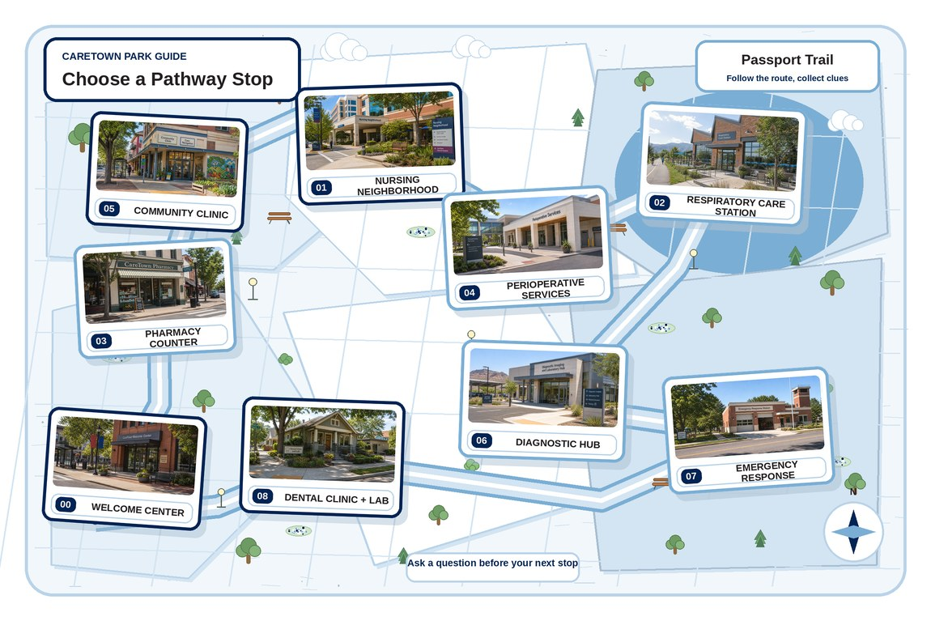
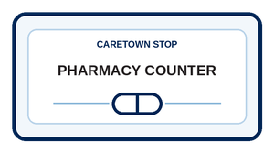
Next stop
Accuracy is a series of careful choices.
Keep exploring Pharmacy Technician, compare it with another stop, or choose a new one.
CareTown · Module 3 · Pharmacy Counter · Unit 4
33

