Slide 1
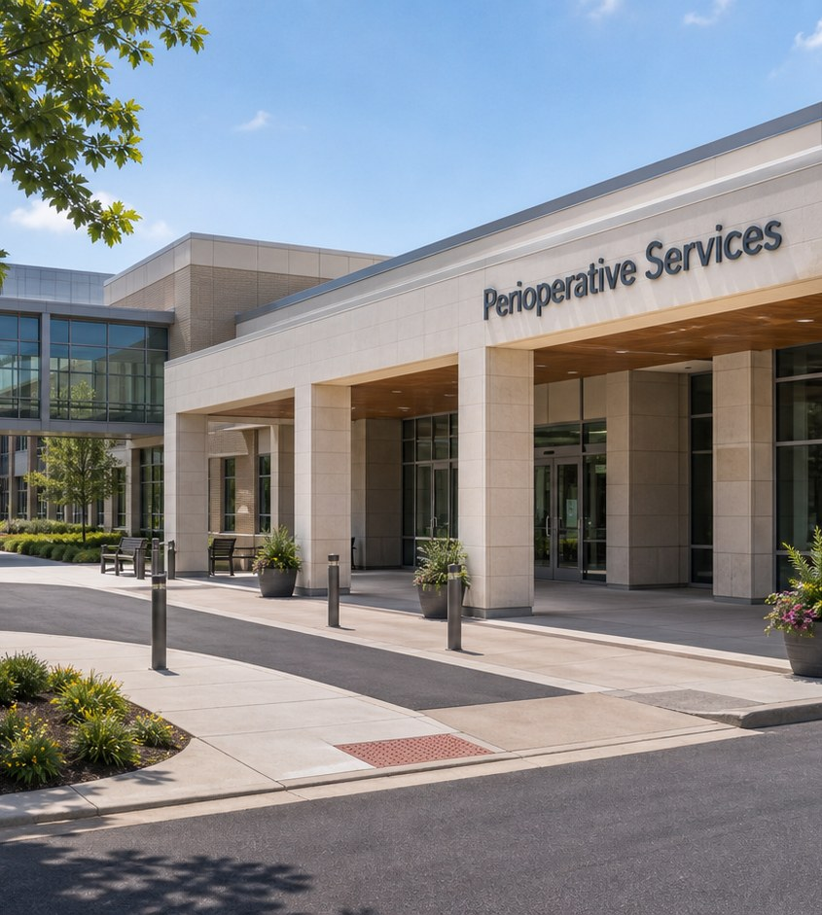
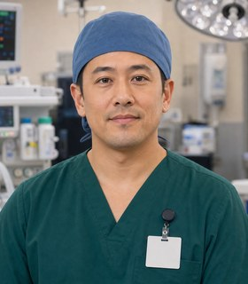

Module 4 · Perioperative Services Pathway
Perioperative Services
Four class periods: the team, training, the workweek, and fit.
Jordan + Camila
01

Slide 2
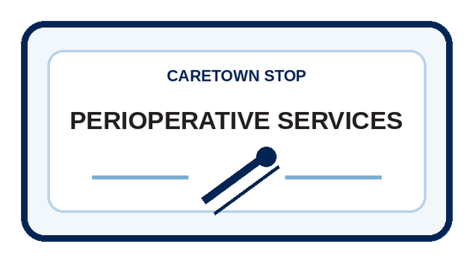
Stop question
What has to be ready before a safe procedure can begin?
Collect clues in every unit. We answer it together in Unit 4.
CareTown · Module 4 · Perioperative Services
02

Slide 3
Stop agenda
Four class periods. One stop.
Period 1
Period 2
Period 3
Period 4
Meet the team
Training week
The workweek
Fit and next steps
O1.1
Exit ticket
O2.1
Exit ticket
O3.1
O3.2
O3.3
Exit ticket
O4.1
O4.2
O4.3
Exit ticket
CareTown · Module 4 · Perioperative Services
03

Slide 4
Unit 1 of 4 · 50-minute class period
5 min
Meet Jordan and Camila
Enter Perioperative Services
15 min
Guide cards, snapshot, quick guide
25 min
O1.1 Perioperative Team and Workflow Map
5 min
Exit ticket
CareTown · Module 4 · Perioperative Services · Unit 1
04

Slide 5

Opener · about 5 minutes
Meet Jordan and Camila
Start on the Perioperative Services webpage.
As you meet them
One thing Jordan does. One question Camila has.
CareTown · Module 4 · Perioperative Services · Unit 1
05

Slide 6
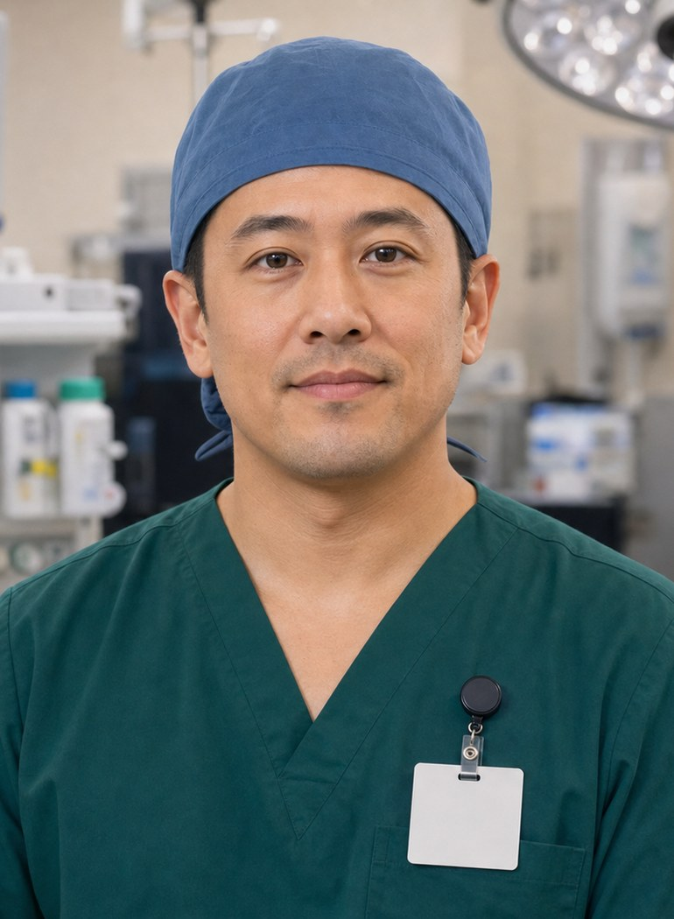
Meet the professional guide
Meet Jordan Lee.
Anesthesia technologist (they/them)
I check the readiness record early.
I keep an open item visible.
I tell the right person what is open.
CareTown · Module 4 · Perioperative Services · Unit 1
06

Slide 7

Meet the student explorer
Meet Camila Reed.
Perioperative services student
What does each role actually do?
Where may a student stand?
Could this fit my life right now?
CareTown · Module 4 · Perioperative Services · Unit 1
07

Slide 8
Pathway snapshot
Surgical technologists at a glance
What they do
Where they work
Median pay
Job growth
Prepare operating rooms and support surgeries
Mostly hospitals and outpatient centers
$64,650
5%
U.S., May 2025
2025-35, faster than average
Source: U.S. Bureau of Labor Statistics, Occupational Outlook Handbook, Surgical Assistants and Technologists, www.bls.gov/ooh/healthcare/surgical-technologists.htm (accessed Oct 9, 2026).
CareTown · Module 4 · Perioperative Services · Unit 1
08

Slide 9
Roles quick guide
Three roles. One ready room.
Surgical technologist
Sterile processing technician
Anesthesia technologist
Prepares the room and supplies; supports the surgical team.
Cleans, inspects, packages, and sterilizes instruments.
Readies anesthesia equipment under anesthesia providers.
CareTown characters are fictional. The job titles are real.
CareTown · Module 4 · Perioperative Services · Unit 1
09

Slide 10

Activity
O1.1 Perioperative Team and Workflow Map
25 min
Solo, pairs, or groups
Workbook p. 117
1
Sort each card to a role or the team.
2
Mark one handoff point.
3
Write one question to verify.
Done when: Every card is placed and one handoff is marked.
CareTown · Module 4 · Perioperative Services · Unit 1
10

Slide 11
Check for understanding
Who moves reusable instruments through cleaning and sterilization?
1
Sterile processing technician
2
Anesthesia technologist
3
The patient
Show 1, 2, or 3 fingers. Then explain why.
CareTown · Module 4 · Perioperative Services · Unit 1
11

Slide 12
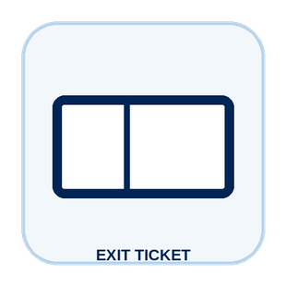
Unit 1 exit ticket
Before you go
5 min
Workbook p. 132
1
Two roles I learned about in this unit.
2
One task or piece of information that moves between them.
CareTown · Module 4 · Perioperative Services · Unit 1
12

Slide 13
Unit 2 of 4 · 50-minute class period
5 min
Recap: one role from Unit 1
Week in the Life of a Perioperative Services Student
10 min
Training route and sample week
30 min
O2.1 Build Camila's Training Week
5 min
Exit ticket
CareTown · Module 4 · Perioperative Services · Unit 2
13

Slide 14

Recap
Name one role from Unit 1.
Today: Camila's training week.
Say the role and one thing it does.
CareTown · Module 4 · Perioperative Services · Unit 2
14

Slide 15
Training route and sample week
A sample week needs more than class time.
Mon
Tue
Wed
Thu
Fri
Every night
class
skills lab
class
clinical exposure
quiz review
anatomy terms
Example only. Ask each program for its current schedule.
CareTown · Module 4 · Perioperative Services · Unit 2
15

Slide 16

Activity
O2.1 Build Camila's Training Week
30 min
Solo, pairs, or groups
Workbook p. 119
1
Place class, skills lab, and clinical.
2
Add travel, meals, study, and rest.
3
Mark one pressure point and one support.
Done when: Your week shows one pressure point and one support.
CareTown · Module 4 · Perioperative Services · Unit 2
16

Slide 17
Check for understanding
What goes into Camila's week first?
1
Free time
2
Class, skills lab, and clinical
3
Nothing is fixed
Show 1, 2, or 3 fingers. Then explain why.
CareTown · Module 4 · Perioperative Services · Unit 2
17

Slide 18
Unit 2 exit ticket
Before you go
5 min
Workbook p. 132
1
One question I would ask a surgical technology or sterile processing program before applying.
2
One support that could help a student in this training.
CareTown · Module 4 · Perioperative Services · Unit 2
18

Slide 19
Unit 3 of 4 · 50-minute class period
2 min
Recap: one week question
Week in the Life of Perioperative Services Work
15 min
O3.1 Podcast Keyword Catcher
14 min
O3.2 Jordan's Readiness Check
14 min
O3.3 Room Readiness Huddle
5 min
Exit ticket
CareTown · Module 4 · Perioperative Services · Unit 3
19

Slide 20
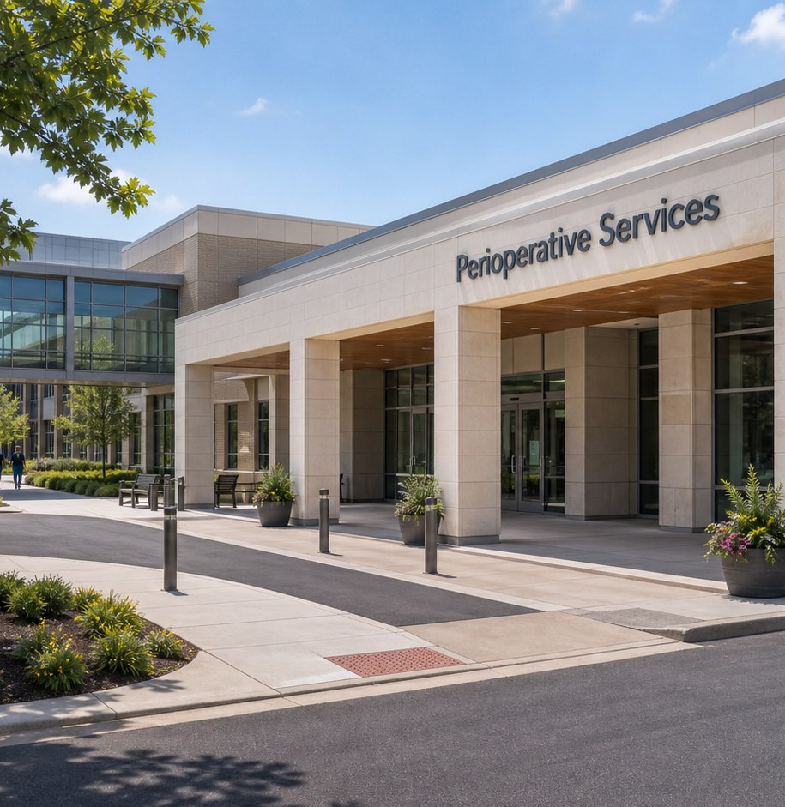
Recap, then the case
One line is still open.
A procedure is getting closer. Jordan finds one open line and does not guess.
First: one question from the training week.
CareTown · Module 4 · Perioperative Services · Unit 3
20

Slide 21

Activity
O3.1 Podcast Keyword Catcher
15 min
Listen as a class
Workbook p. 121
1
Listen or read along.
2
Write three to five keywords.
3
Write one question to verify.
Done when: Three keywords, one idea, and one question are written.
CareTown · Module 4 · Perioperative Services · Unit 3
21

Slide 22

Activity
O3.2 Jordan's Readiness Check
14 min
Class vote or pairs
Workbook p. 122
1
Read each fictional moment.
2
Choose the strongest next move.
3
Name what Jordan or Camila protects.
Done when: Every choice has an answer and a reason.
CareTown · Module 4 · Perioperative Services · Unit 3
22

Slide 23
Safe communication pattern
Keep the open item visible.
Confirmed
Still open
Escalate
Name the item or status already checked.
Name what is missing or unclear.
Tell the trained person before work continues.
CareTown · Module 4 · Perioperative Services · Unit 3
23

Slide 24
Activity
O3.3 Room Readiness Huddle
14 min
Solo, then compare
Workbook p. 125
1
Name the work zone.
2
Write what is confirmed and still open.
3
Name the trained person to tell.
Done when: All four boxes are clear; the last names a trained person.
CareTown · Module 4 · Perioperative Services · Unit 3
24

Slide 25
Check for understanding
One line on the readiness record is still open. Best move?
1
Assume it is usually there
2
Skip it this once
3
Keep it visible; tell the right person
Show 1, 2, or 3 fingers. Then explain why.
CareTown · Module 4 · Perioperative Services · Unit 3
25

Slide 26
Unit 3 exit ticket
Before you go
5 min
Workbook p. 133
1
One exact fact a perioperative team member must get right.
2
The person or role who should receive that fact.
CareTown · Module 4 · Perioperative Services · Unit 3
26

Slide 27
Unit 4 of 4 · 50-minute class period
3 min
Recap: one clue
Perioperative Services Fit Check
15 min
O4.1 Strengths and Fit Check
10 min
O4.2 Practical Factor Check
17 min
O4.3 Career Passport and Next-Step Planner
5 min
Exit ticket
CareTown · Module 4 · Perioperative Services · Unit 4
27

Slide 28
Recap: name one clue from this stop
Meaningful does not mean easy.
Why people choose it
What can be hard
Hands-on teamwork
Time pressure
Useful routines
Standing and protective gear
Behind-the-scenes impact
Nights or on-call
CareTown · Module 4 · Perioperative Services · Unit 4
28

Slide 29

Activity
O4.1 Perioperative Services Strengths and Fit Check
15 min
Individual · share optional
Workbook p. 127
1
Check strengths that fit.
2
Name one skill to build.
3
Choose yes, maybe, or not right now.
Done when: Three strengths, two lines, and a reasoned fit answer.
CareTown · Module 4 · Perioperative Services · Unit 4
29

Slide 30

Activity
O4.2 Practical Factor Check
10 min
Individual · may stay private
Workbook p. 128
1
Mark every practical factor.
2
Name one factor to learn about.
3
Name one person or place to ask.
Done when: Every row is marked; one factor and one source are named.
CareTown · Module 4 · Perioperative Services · Unit 4
30

Slide 31

Activity
O4.3 Career Passport and Next-Step Planner
17 min
Individual writing
Workbook p. 130
1
Write one fact to verify.
2
Choose one next step.
3
Name one trusted person or source.
Done when: One fact, one next step, and one source are written.
CareTown · Module 4 · Perioperative Services · Unit 4
31

Slide 32
Unit 4 exit ticket
Before you go
5 min
Workbook p. 133
1
One action I will take next, and how it connects to my O4.1 fit answer.
2
One trusted source I will use.
CareTown · Module 4 · Perioperative Services · Unit 4
32

Slide 33
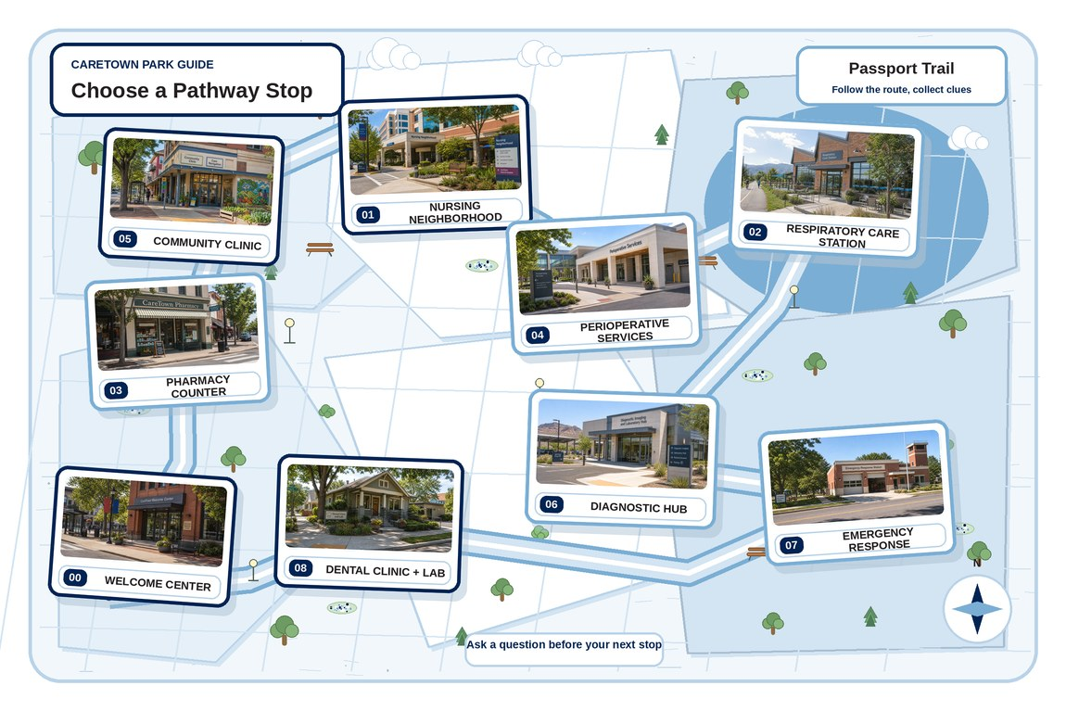
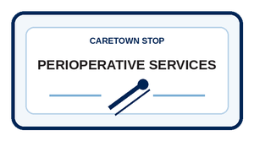
Next stop
Safe care starts before the patient arrives.
Keep exploring Perioperative Services, compare it with another stop, or choose a new one.
CareTown · Module 4 · Perioperative Services · Unit 4
33

