Slide 1
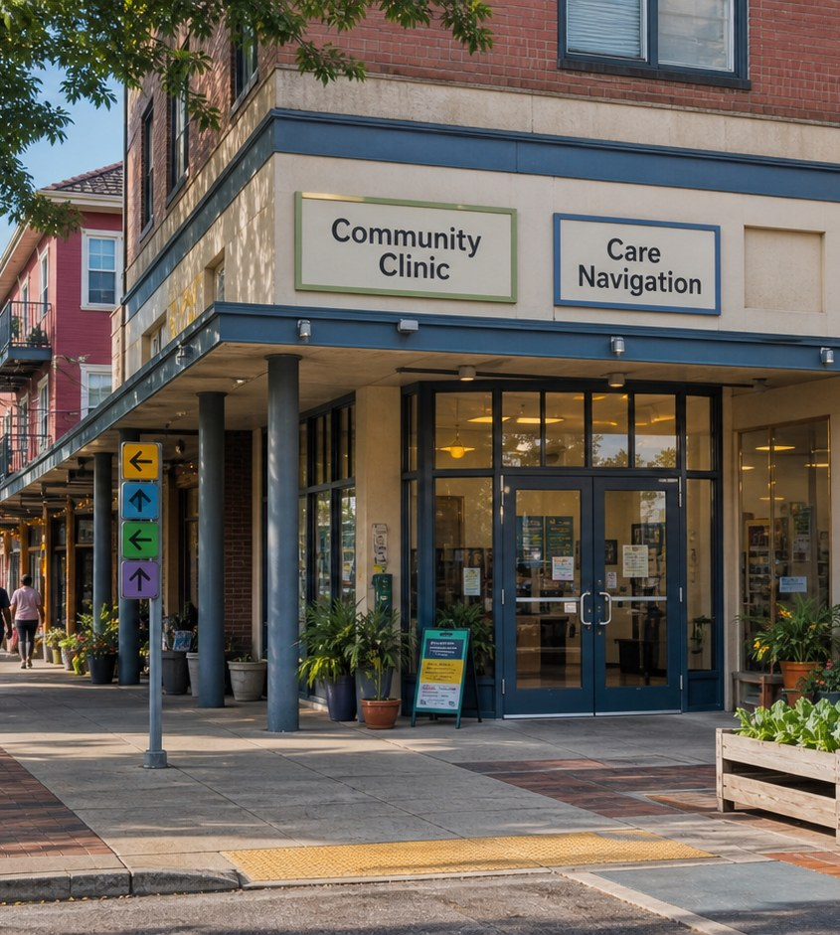
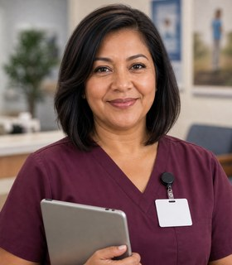

Module 5 · Outpatient and Community Care Pathway
Community Clinic
Four class periods: the team, training, the workweek, and fit.
Rosa + Amara
01

Slide 2
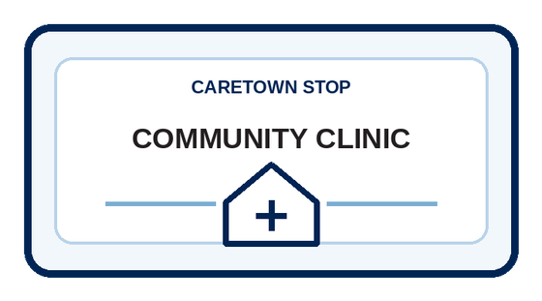
Stop question
How does important information reach the right person after a visit?
Collect clues in every unit. We answer it together in Unit 4.
CareTown · Module 5 · Community Clinic
02

Slide 3
Stop agenda
Four class periods. One stop.
Period 1
Period 2
Period 3
Period 4
Meet the team
Training week
The workweek
Fit and next steps
C1.1
Exit ticket
C2.1
Exit ticket
C3.1
C3.2
C3.3
Exit ticket
C4.1
C4.2
C4.3
Exit ticket
CareTown · Module 5 · Community Clinic
03

Slide 4
Unit 1 of 4 · 50-minute class period
5 min
Meet Rosa and Amara
Enter Outpatient and Community Care
15 min
Guide cards, snapshot, quick guide
25 min
C1.1 Patient Flow and Care Team Map
5 min
Exit ticket
CareTown · Module 5 · Community Clinic · Unit 1
04

Slide 5

Opener · about 5 minutes
Meet Rosa and Amara
Start on the Community Clinic webpage.
As you meet them
One thing Rosa does. One question Amara has.
CareTown · Module 5 · Community Clinic · Unit 1
05

Slide 6
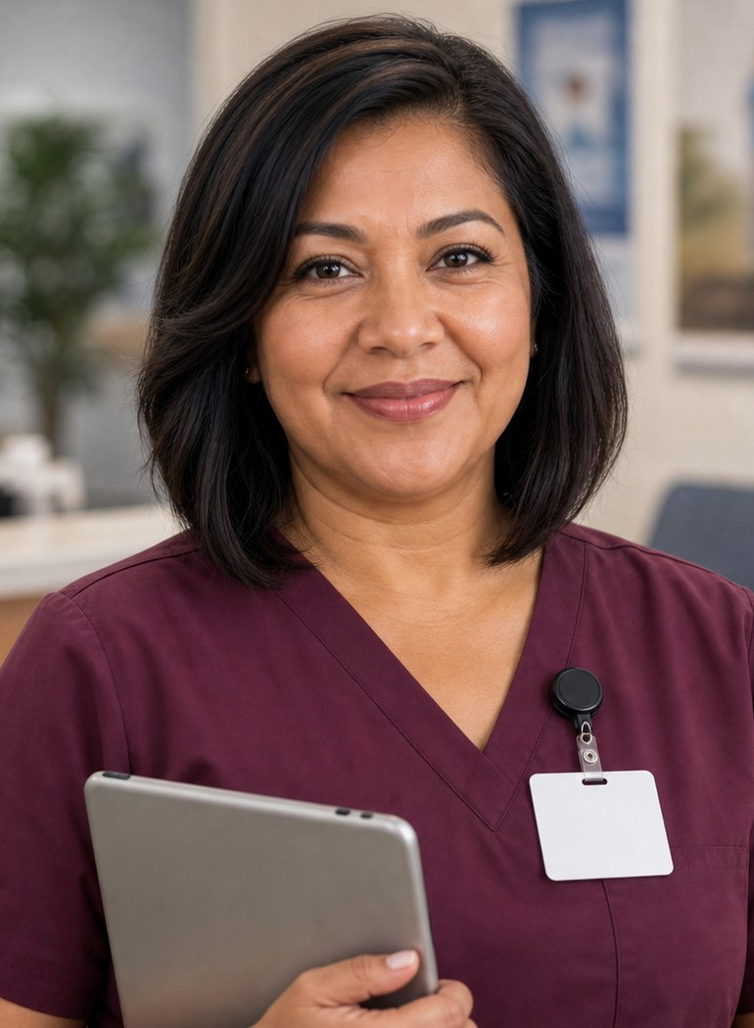
Meet the professional guide
Meet Rosa Martinez.
Medical assistant and care coordinator
I welcome patients without blame.
I ask instead of guessing.
I record the patient's exact words.
CareTown · Module 5 · Community Clinic · Unit 1
06

Slide 7
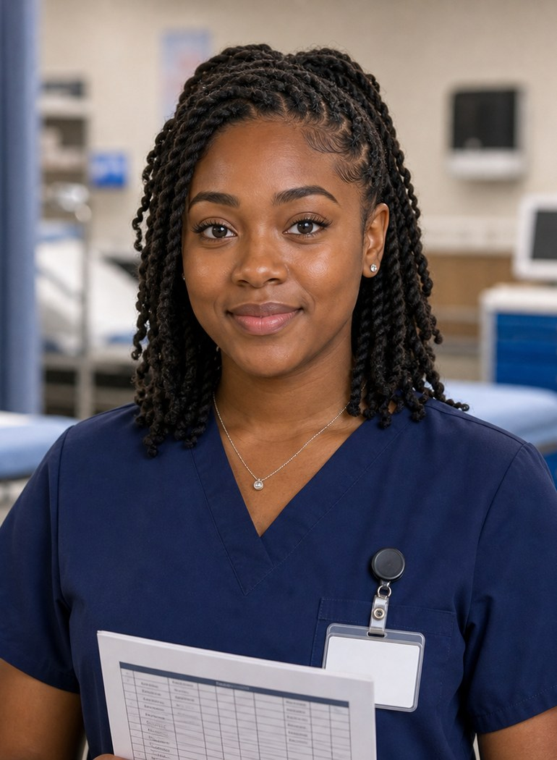
Meet the student explorer
Meet Amara Wilson.
Medical assisting student
What does each clinic role do?
What do I say when I do not know?
Could this fit my life right now?
CareTown · Module 5 · Community Clinic · Unit 1
07

Slide 8
Pathway snapshot
Medical assistants at a glance
What they do
Where they work
Median pay
Job growth
Clinical and office tasks that keep clinics running
Physicians' offices, hospitals, outpatient care
$45,690
13%
U.S., May 2025
2025-35, much faster than average
Source: U.S. Bureau of Labor Statistics, Occupational Outlook Handbook, Medical Assistants, www.bls.gov/ooh/healthcare/medical-assistants.htm (accessed Oct 9, 2026).
CareTown · Module 5 · Community Clinic · Unit 1
08

Slide 9
Roles quick guide
Clinic care takes a team.
Medical assistant
Phlebotomy technician
Community health worker
Supports intake, records, rooms, and approved tasks.
Collects blood samples under a California certificate.
Helps people reach services and prepare for visits.
CareTown characters are fictional. The job titles are real.
CareTown · Module 5 · Community Clinic · Unit 1
09

Slide 10
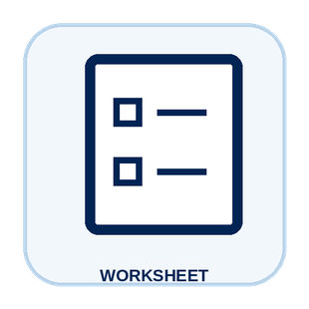
Activity
C1.1 Patient Flow and Care Team Map
25 min
Solo, pairs, or groups
Workbook p. 141
1
Order the five visit stages.
2
Name the role at each handoff.
3
Write one question to clarify.
Done when: Every stage has a role; one handoff is marked.
CareTown · Module 5 · Community Clinic · Unit 1
10

Slide 11
Check for understanding
Who collects blood samples under a California certificate?
1
Front-office worker
2
Phlebotomy technician
3
Community health worker
Show 1, 2, or 3 fingers. Then explain why.
CareTown · Module 5 · Community Clinic · Unit 1
11

Slide 12
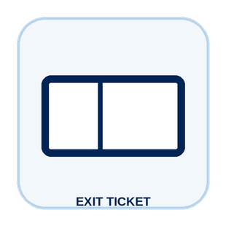
Unit 1 exit ticket
Before you go
5 min
Workbook p. 156
1
Two roles I learned about in this unit.
2
One task or piece of information that moves between them.
CareTown · Module 5 · Community Clinic · Unit 1
12

Slide 13
Unit 2 of 4 · 50-minute class period
5 min
Recap: one role from Unit 1
Week in the Life of an Outpatient and Community Care Student
10 min
Training route and sample week
30 min
C2.1 Build Amara's Week
5 min
Exit ticket
CareTown · Module 5 · Community Clinic · Unit 2
13

Slide 14

Recap
Name one role from Unit 1.
Today: Amara's training week.
Say the role and one thing it does.
CareTown · Module 5 · Community Clinic · Unit 2
14

Slide 15
Training route and sample week
A sample week needs more than class time.
Mon
Tue
Wed
Thu
Fri
Every night
class
skills practice
class
skills practice
externship meeting
medical terms
Example only. Ask each program for its current schedule.
CareTown · Module 5 · Community Clinic · Unit 2
15

Slide 16
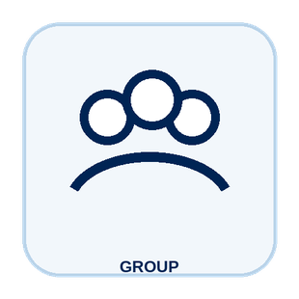
Activity
C2.1 Build Amara's Week
30 min
Solo, pairs, or groups
Workbook p. 143
1
Place class and skills practice first.
2
Add travel, food, study, and rest.
3
Mark one pressure point and one support.
Done when: Your week shows one pressure point and one support.
CareTown · Module 5 · Community Clinic · Unit 2
16

Slide 17
Check for understanding
What does Amara's week need besides class?
1
Skills practice, travel, study, rest
2
Nothing else
3
Only the externship
Show 1, 2, or 3 fingers. Then explain why.
CareTown · Module 5 · Community Clinic · Unit 2
17

Slide 18
Unit 2 exit ticket
Before you go
5 min
Workbook p. 156
1
One question I would ask a medical assisting or phlebotomy program before applying.
2
One support that could help a student in this training.
CareTown · Module 5 · Community Clinic · Unit 2
18

Slide 19
Unit 3 of 4 · 50-minute class period
2 min
Recap: one week question
Week in the Life of Outpatient and Community Care Work
15 min
C3.1 Podcast Keyword Catcher
14 min
C3.2 Rosa's Follow-Up Visit
14 min
C3.3 Care Navigation Huddle
5 min
Exit ticket
CareTown · Module 5 · Community Clinic · Unit 3
19

Slide 20
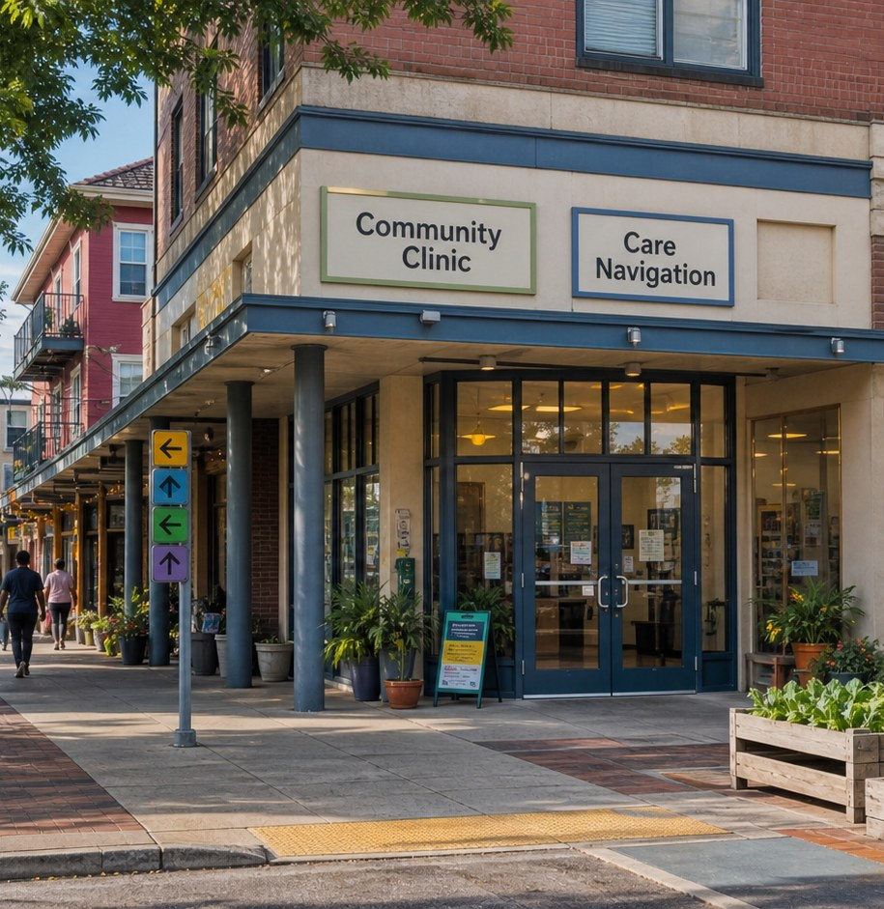
Recap, then the case
A patient comes back.
A patient missed a follow-up visit and says, "I could not get a ride last time."
First: one question from the training week.
CareTown · Module 5 · Community Clinic · Unit 3
20

Slide 21

Activity
C3.1 Podcast Keyword Catcher
15 min
Listen as a class
Workbook p. 145
1
Listen or read along.
2
Write three to five keywords.
3
Write one question to verify.
Done when: Three keywords, one idea, and one question are written.
CareTown · Module 5 · Community Clinic · Unit 3
21

Slide 22

Activity
C3.2 Rosa's Follow-Up Visit
14 min
Class vote or pairs
Workbook p. 146
1
Read each fictional moment.
2
Choose the strongest next move.
3
Name what Rosa protects.
Done when: Every choice has an answer and a reason.
CareTown · Module 5 · Community Clinic · Unit 3
22

Slide 23
Safe communication pattern
Keep the patient's exact words.
Notice
Ask
Connect
Write exact words and facts. No guessed cause.
Use one respectful, open question.
Route the need to the qualified person.
CareTown · Module 5 · Community Clinic · Unit 3
23

Slide 24
Activity
C3.3 Care Navigation Huddle
14 min
Solo, then compare
Workbook p. 149
1
Notice: write the exact words.
2
Ask one respectful question.
3
Connect and close the loop.
Done when: All four parts are clear and name a qualified role.
CareTown · Module 5 · Community Clinic · Unit 3
24

Slide 25
Check for understanding
A patient says, "I could not get a ride." What does Rosa record?
1
A guess about why
2
The patient's exact words
3
Nothing at all
Show 1, 2, or 3 fingers. Then explain why.
CareTown · Module 5 · Community Clinic · Unit 3
25

Slide 26
Unit 3 exit ticket
Before you go
5 min
Workbook p. 157
1
One exact fact a medical assistant must get right.
2
The person or role who should receive that fact.
CareTown · Module 5 · Community Clinic · Unit 3
26

Slide 27
Unit 4 of 4 · 50-minute class period
3 min
Recap: one clue
Outpatient and Community Care Fit Check
15 min
C4.1 Strengths and Fit Check
10 min
C4.2 Practical Factor Check
17 min
C4.3 Career Passport and Next-Step Planner
5 min
Exit ticket
CareTown · Module 5 · Community Clinic · Unit 4
27

Slide 28
Recap: name one clue from this stop
Meaningful does not mean easy.
Why people choose it
What can be hard
Welcomed and heard
Fast pace
Clearer next steps
Private information
Organized team
Worried patients
CareTown · Module 5 · Community Clinic · Unit 4
28

Slide 29

Activity
C4.1 Outpatient and Community Care Strengths and Fit Check
15 min
Individual · share optional
Workbook p. 150
1
Check strengths that fit.
2
Name one skill to build.
3
Choose yes, maybe, or not right now.
Done when: Three strengths, two lines, and a reasoned fit answer.
CareTown · Module 5 · Community Clinic · Unit 4
29

Slide 30
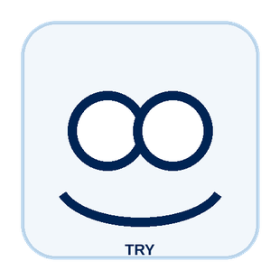
Activity
C4.2 Practical Factor Check
10 min
Individual · may stay private
Workbook p. 152
1
Mark every practical factor.
2
Name one factor to learn about.
3
Name one person or place to ask.
Done when: Every row is marked; one factor and one source are named.
CareTown · Module 5 · Community Clinic · Unit 4
30

Slide 31

Activity
C4.3 Career Passport and Next-Step Planner
17 min
Individual writing
Workbook p. 154
1
Write one fact to verify.
2
Choose one next step.
3
Name one trusted person or source.
Done when: One fact, one next step, and one source are written.
CareTown · Module 5 · Community Clinic · Unit 4
31

Slide 32
Unit 4 exit ticket
Before you go
5 min
Workbook p. 157
1
One action I will take next, and how it connects to my C4.1 fit answer.
2
One trusted source I will use.
CareTown · Module 5 · Community Clinic · Unit 4
32

Slide 33
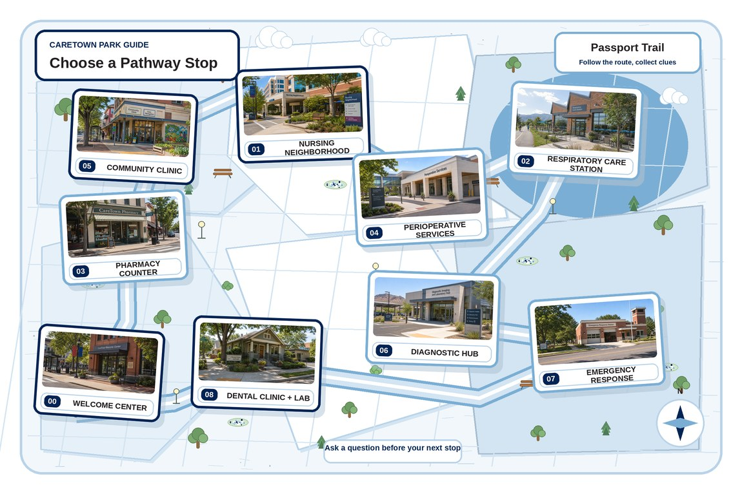
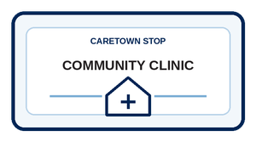
Next stop
Closing the loop is part of care.
Keep exploring Outpatient and Community Care, compare it with another stop, or choose a new one.
CareTown · Module 5 · Community Clinic · Unit 4
33

