Slide 1
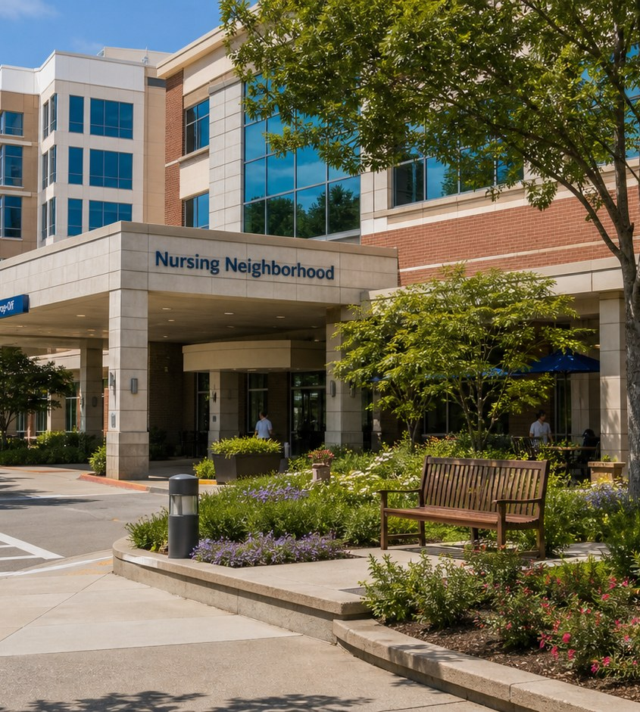

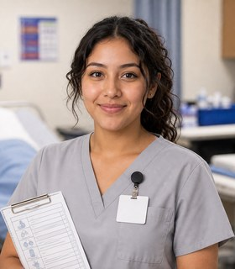
Module 1 · Nursing Pathway
Nursing Neighborhood
Four class periods: the team, training, the workweek, and fit.
Elena + Maya
01

Slide 2
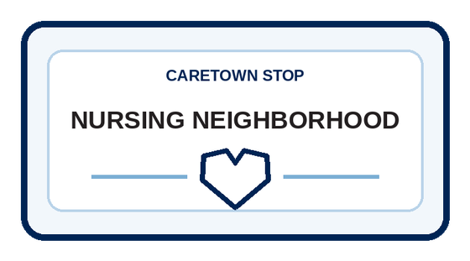
Stop question
Who notices first, and how does the team respond?
Collect clues in every unit. We answer it together in Unit 4.
CareTown · Module 1 · Nursing Neighborhood
02

Slide 3
Stop agenda
Four class periods. One stop.
Period 1
Period 2
Period 3
Period 4
Meet the team
Training week
The workweek
Fit and next steps
N1.1
Exit ticket
N2.1
Exit ticket
N3.1
N3.2
N3.3
Exit ticket
N4.1
N4.2
N4.3
Exit ticket
CareTown · Module 1 · Nursing Neighborhood
03

Slide 4
Unit 1 of 4 · 50-minute class period
5 min
Meet Elena and Maya
Enter the Nursing Pathway
15 min
Guide cards, snapshot, quick guide
25 min
N1.1 Nursing Routes and Role Sort
5 min
Exit ticket
CareTown · Module 1 · Nursing Neighborhood · Unit 1
04

Slide 5

Opener · about 5 minutes
Meet Elena and Maya
Start on the Nursing Neighborhood webpage.
As you meet them
One thing Elena does. One question Maya has.
CareTown · Module 1 · Nursing Neighborhood · Unit 1
05

Slide 6

Meet the professional guide
Meet Elena Ramirez.
Registered nurse (RN)
I notice when something changes.
I call in the team when safety changes.
I stay calm when the room gets loud.
CareTown · Module 1 · Nursing Neighborhood · Unit 1
06

Slide 7

Meet the student explorer
Meet Maya Torres.
Nursing student
What does this role actually do?
What would training ask of my week?
Could this fit my life right now?
CareTown · Module 1 · Nursing Neighborhood · Unit 1
07

Slide 8
Pathway snapshot
Registered nurses at a glance
What they do
Where they work
Median pay
Job growth
Assess, plan, and coordinate patient care
Hospitals, clinics, home health, schools
$97,550
6%
U.S., May 2025
2025-35, faster than average
Source: U.S. Bureau of Labor Statistics, Occupational Outlook Handbook, Registered Nurses, www.bls.gov/ooh/healthcare/registered-nurses.htm (accessed Oct 9, 2026).
CareTown · Module 1 · Nursing Neighborhood · Unit 1
08

Slide 9
Roles quick guide
Nursing is not one job.
Nursing assistant
Licensed vocational nurse
Registered nurse
Supports safety, comfort, and basic care after certification.
Gives basic nursing care under an RN or physician.
Assesses, teaches, and coordinates care within the RN scope.
CareTown characters are fictional. The job titles are real.
CareTown · Module 1 · Nursing Neighborhood · Unit 1
09

Slide 10

Activity
N1.1 Nursing Routes and Role Sort
25 min
Solo, pairs, or groups
Workbook p. 40
1
Sort each task card by role.
2
Name what you still need to verify.
3
Unsure? Use: check the rules.
Done when: Every card is sorted and one rule is named.
CareTown · Module 1 · Nursing Neighborhood · Unit 1
10

Slide 11
Check for understanding
Who uses nursing judgment to assess and plan care?
1
Nursing assistant
2
Registered nurse
3
Any visitor
Show 1, 2, or 3 fingers. Then explain why.
CareTown · Module 1 · Nursing Neighborhood · Unit 1
11

Slide 12
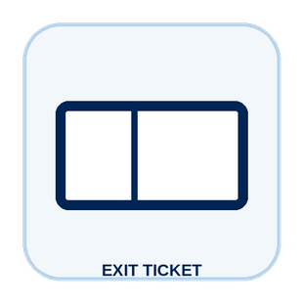
Unit 1 exit ticket
Before you go
5 min
Workbook p. 55
1
Two roles I learned about in this unit.
2
One task or piece of information that moves between them.
CareTown · Module 1 · Nursing Neighborhood · Unit 1
12

Slide 13
Unit 2 of 4 · 50-minute class period
5 min
Recap: one role from Unit 1
Week in the Life of a Nursing Student
10 min
Training route and sample week
30 min
N2.1 Build Maya's Training Week
5 min
Exit ticket
CareTown · Module 1 · Nursing Neighborhood · Unit 2
13

Slide 14

Recap
Name one role from Unit 1.
Today: Maya's training week.
Say the role and one thing it does.
CareTown · Module 1 · Nursing Neighborhood · Unit 2
14

Slide 15
Training route and sample week
A sample week needs more than class time.
Mon
Tue
Wed
Thu
Fri
Weekend
class
skills lab
study + travel
clinical prep
clinical
rest + review
Example only. Ask each program for its current schedule.
CareTown · Module 1 · Nursing Neighborhood · Unit 2
15

Slide 16

Activity
N2.1 Build Maya's Training Week
30 min
Solo, pairs, or groups
Workbook p. 42
1
Place required training blocks first.
2
Add travel, meals, and rest.
3
Mark one pressure point and one support.
Done when: Your week shows one pressure point and one support.
CareTown · Module 1 · Nursing Neighborhood · Unit 2
16

Slide 17
Check for understanding
Maya's week has class, lab, and clinical. What else must fit?
1
Nothing else
2
Travel, meals, study, and rest
3
Only weekend plans
Show 1, 2, or 3 fingers. Then explain why.
CareTown · Module 1 · Nursing Neighborhood · Unit 2
17

Slide 18
Unit 2 exit ticket
Before you go
5 min
Workbook p. 55
1
One question I would ask a nursing program before applying.
2
One support that could help a student in this training.
CareTown · Module 1 · Nursing Neighborhood · Unit 2
18

Slide 19
Unit 3 of 4 · 50-minute class period
2 min
Recap: one week question
Week in the Life of Nursing Work
15 min
N3.1 Podcast Keyword Catcher
14 min
N3.2 Elena's Busy Shift
14 min
N3.3 Team Handoff Huddle
5 min
Exit ticket
CareTown · Module 1 · Nursing Neighborhood · Unit 3
19

Slide 20
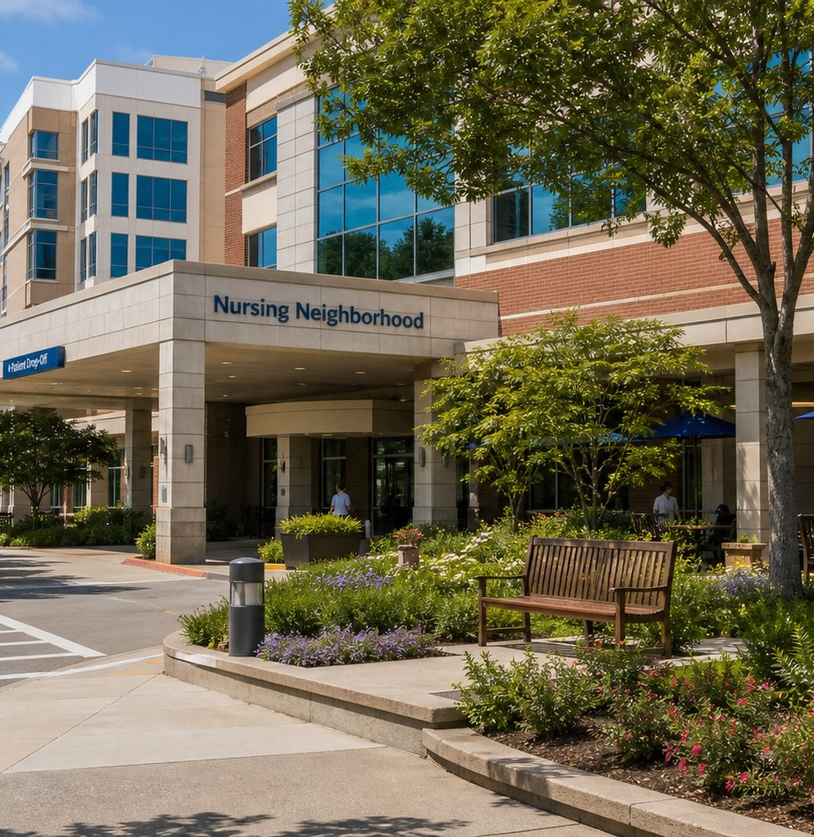
Recap, then the case
The discharge clock is ticking.
Mr. Alvarez is ready to leave. Then he grips the rail: "My chest feels tight."
First: one question from the training week.
CareTown · Module 1 · Nursing Neighborhood · Unit 3
20

Slide 21

Activity
N3.1 Podcast Keyword Catcher
15 min
Listen, then share
Workbook p. 44
1
Listen or read the transcript.
2
Write three to five keywords.
3
Explain one word to a partner.
Done when: Three keywords and one question are written.
CareTown · Module 1 · Nursing Neighborhood · Unit 3
21

Slide 22

Activity
N3.2 Elena's Busy Shift
14 min
Class vote or pairs
Workbook p. 45
1
Read each fictional scene.
2
Choose the safest next move.
3
Name what Elena notices or protects.
Done when: Every choice has an answer and a reason.
CareTown · Module 1 · Nursing Neighborhood · Unit 3
22

Slide 23
Safe communication pattern
Notice, call for help, protect.
Notice
Call for help
Protect
Listen to the patient's exact words.
Give a clear signal to the right support.
Pause the routine and stay present.
CareTown · Module 1 · Nursing Neighborhood · Unit 3
23

Slide 24
Activity
N3.3 Team Handoff Huddle
14 min
Solo, then compare
Workbook p. 49
1
Name the situation.
2
Write the exact words you noticed.
3
Name the help that is needed.
Done when: Your handoff names a situation, observation, and need.
CareTown · Module 1 · Nursing Neighborhood · Unit 3
24

Slide 25
Check for understanding
Mr. Alvarez says his chest feels tight. What does Elena do first?
1
Finish the discharge papers
2
Guess the cause out loud
3
Notice, call for help, protect
Show 1, 2, or 3 fingers. Then explain why.
CareTown · Module 1 · Nursing Neighborhood · Unit 3
25

Slide 26
Unit 3 exit ticket
Before you go
5 min
Workbook p. 56
1
One exact fact a nurse must get right.
2
The person or role who should receive that fact.
CareTown · Module 1 · Nursing Neighborhood · Unit 3
26

Slide 27
Unit 4 of 4 · 50-minute class period
3 min
Recap: one clue
Nursing Fit Check and Next Steps
15 min
N4.1 Strengths and Fit Check
10 min
N4.2 Practical Factor Check
17 min
N4.3 Career Passport and Next-Step Planner
5 min
Exit ticket
CareTown · Module 1 · Nursing Neighborhood · Unit 4
27

Slide 28
Recap: name one clue from this stop
Meaningful does not mean easy.
Why people choose it
What can be hard
Human impact
Rooms change quickly
Skilled action
Careful documentation
Team belonging
Time and energy
CareTown · Module 1 · Nursing Neighborhood · Unit 4
28

Slide 29

Activity
N4.1 Nursing Strengths and Fit Check
15 min
Individual · share optional
Workbook p. 51
1
Check strengths that fit.
2
Name one skill to build.
3
Choose yes, maybe, or not right now.
Done when: Three strengths, two lines, and a reasoned fit answer.
CareTown · Module 1 · Nursing Neighborhood · Unit 4
29

Slide 30

Activity
N4.2 Practical Factor Check
10 min
Individual · may stay private
Workbook p. 52
1
Mark every practical factor.
2
Name one factor to learn about.
3
Name one person or place to ask.
Done when: Every row is marked; one factor and one source are named.
CareTown · Module 1 · Nursing Neighborhood · Unit 4
30

Slide 31

Activity
N4.3 Career Passport and Next-Step Planner
17 min
Individual writing
Workbook p. 53
1
Write one fact to verify.
2
Choose one next step.
3
Name one trusted person or source.
Done when: One fact, one next step, and one source are written.
CareTown · Module 1 · Nursing Neighborhood · Unit 4
31

Slide 32
Unit 4 exit ticket
Before you go
5 min
Workbook p. 56
1
One action I will take next, and how it connects to my N4.1 fit answer.
2
One trusted source I will use.
CareTown · Module 1 · Nursing Neighborhood · Unit 4
32

Slide 33
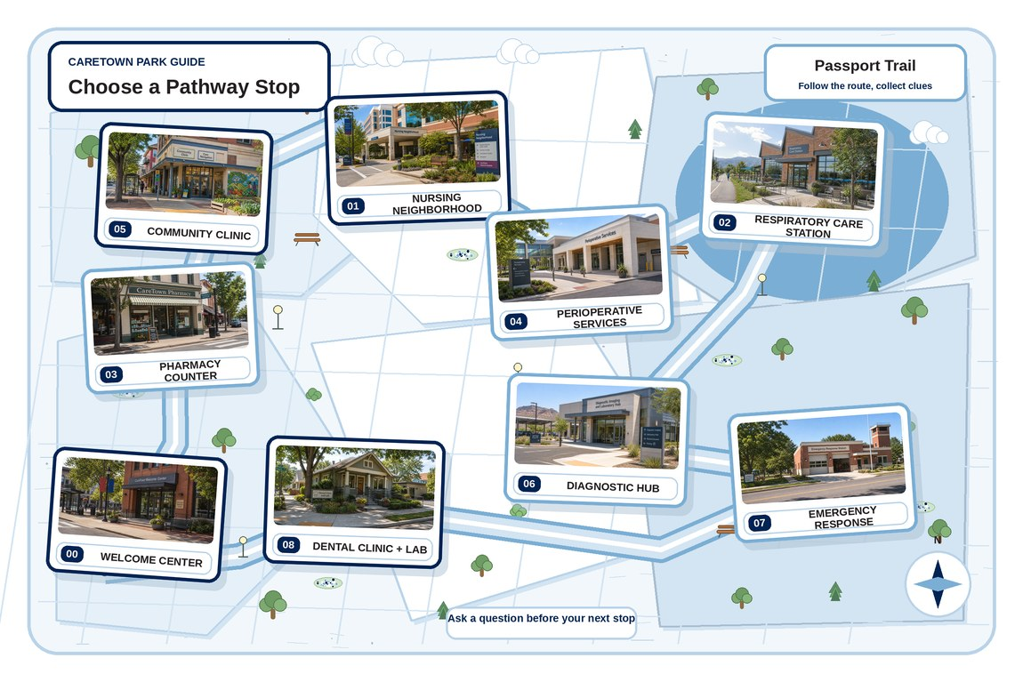
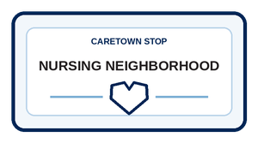
Next stop
Nursing is where skill meets trust.
Keep exploring Nursing, compare it with another stop, or choose a new one.
CareTown · Module 1 · Nursing Neighborhood · Unit 4
33

