Slide 1
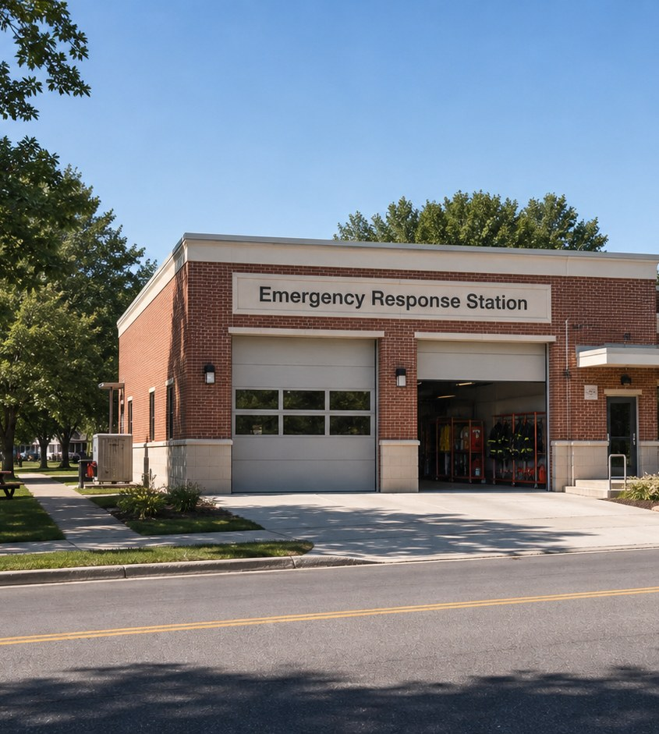
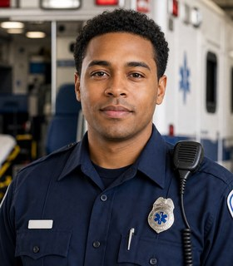
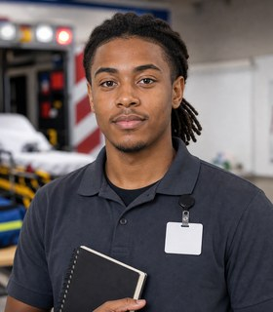
Module 7 · Emergency Response Pathway
Emergency Response Station
Four class periods: the team, training, the workweek, and fit.
Marcus + Jayden
01

Slide 2
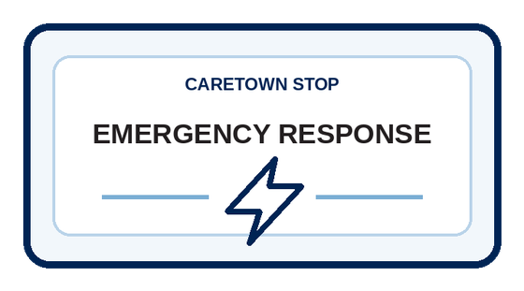
Stop question
What must not get lost between the call and the handoff?
Collect clues in every unit. We answer it together in Unit 4.
CareTown · Module 7 · Emergency Response Station
02

Slide 3
Stop agenda
Four class periods. One stop.
Period 1
Period 2
Period 3
Period 4
Meet the team
Training week
The workweek
Fit and next steps
E1.1
Exit ticket
E2.1
Exit ticket
E3.1
E3.2
E3.3
Exit ticket
E4.1
E4.2
E4.3
Exit ticket
CareTown · Module 7 · Emergency Response Station
03

Slide 4
Unit 1 of 4 · 50-minute class period
5 min
Meet Marcus and Jayden
Follow the Emergency Response Chain
15 min
Guide cards, snapshot, quick guide
25 min
E1.1 Response Chain Map
5 min
Exit ticket
CareTown · Module 7 · Emergency Response Station · Unit 1
04

Slide 5

Opener · about 5 minutes
Meet Marcus and Jayden
Start on the Emergency Response Station webpage.
As you meet them
One thing Marcus does. One question Jayden has.
CareTown · Module 7 · Emergency Response Station · Unit 1
05

Slide 6
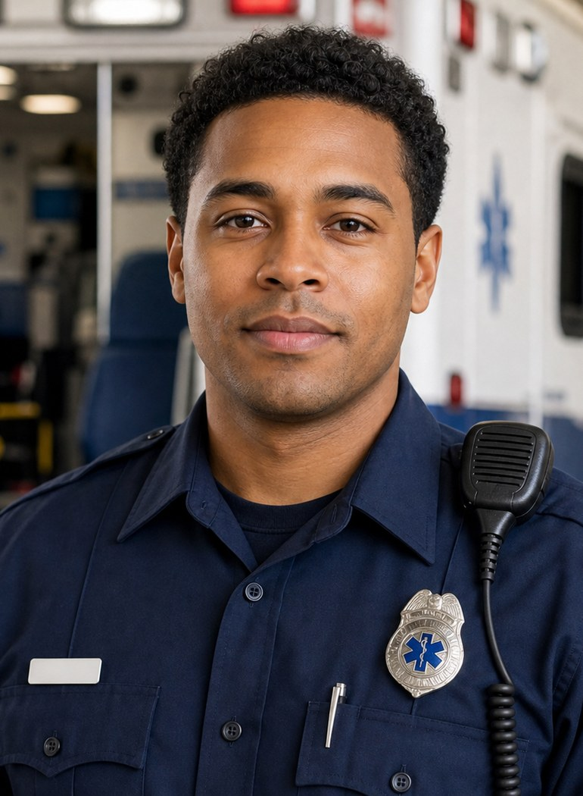
Meet the professional guide
Meet Marcus Reed.
Emergency medical technician (EMT)
I prepare before the call.
I use exact words and observations.
I follow team procedures.
CareTown · Module 7 · Emergency Response Station · Unit 1
06

Slide 7
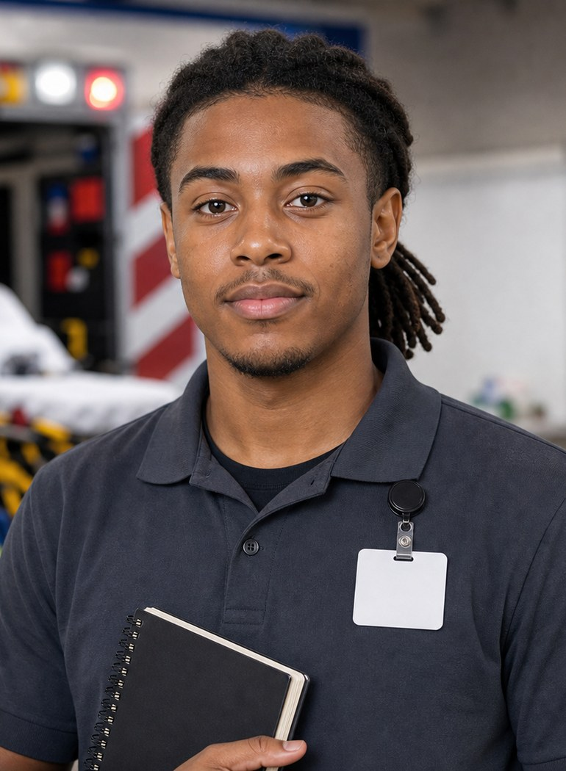
Meet the student explorer
Meet Jayden Brooks.
EMT student
What does an EMT student week include?
What official steps follow the course?
What support could help?
CareTown · Module 7 · Emergency Response Station · Unit 1
07

Slide 8
Pathway snapshot
Emergency medical technicians at a glance
What they do
Where they work
Median pay
Job growth
Assess, care for, and transport patients
Ambulance services, local government, hospitals
$44,470
6%
U.S., May 2025
2025-35, faster than average
Source: U.S. Bureau of Labor Statistics, Occupational Outlook Handbook, EMTs and Paramedics, www.bls.gov/ooh/healthcare/emts-and-paramedics.htm (accessed Oct 9, 2026).
CareTown · Module 7 · Emergency Response Station · Unit 1
08

Slide 9
Roles quick guide
Emergency response is a chain.
Call taker or dispatcher
EMT
Paramedic
Receives, confirms, sends, and tracks information.
Gives prehospital care within EMT training and rules.
Advanced training, a California license, local rules.
CareTown characters are fictional. The job titles are real.
CareTown · Module 7 · Emergency Response Station · Unit 1
09

Slide 10

Activity
E1.1 Response Chain Map
25 min
Solo, pairs, or groups
Workbook p. 187
1
Place at least six roles.
2
Label four information handoffs.
3
Explain what could be lost.
Done when: Six roles are placed and four handoffs are labeled.
CareTown · Module 7 · Emergency Response Station · Unit 1
10

Slide 11
Check for understanding
Who receives the 911 call and sends the response?
1
Call taker or dispatcher
2
ED technician
3
Paramedic
Show 1, 2, or 3 fingers. Then explain why.
CareTown · Module 7 · Emergency Response Station · Unit 1
11

Slide 12
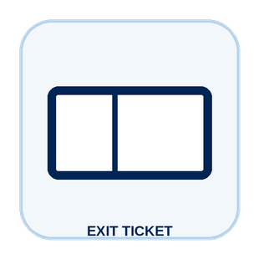
Unit 1 exit ticket
Before you go
5 min
Workbook p. 203
1
Two roles I learned about in this unit.
2
One task or piece of information that moves between them.
CareTown · Module 7 · Emergency Response Station · Unit 1
12

Slide 13
Unit 2 of 4 · 50-minute class period
5 min
Recap: one role from Unit 1
Build Jayden's EMT Training Week
10 min
Training route and sample week
30 min
E2.1 Build Jayden's EMT Training Week
5 min
Exit ticket
CareTown · Module 7 · Emergency Response Station · Unit 2
13

Slide 14

Recap
Name one role from Unit 1.
Today: Jayden's training week.
Say the role and one thing it does.
CareTown · Module 7 · Emergency Response Station · Unit 2
14

Slide 15
Training route and sample week
A sample week needs more than class time.
Mon
Tue
Wed
Thu
Fri
Weekend
class
lab
study
travel + prep
practice
rest + review
Example only. Ask each program for its current schedule.
CareTown · Module 7 · Emergency Response Station · Unit 2
15

Slide 16
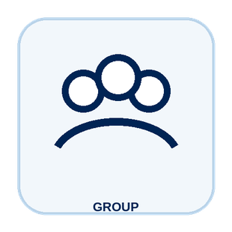
Activity
E2.1 Build Jayden's EMT Training Week
30 min
Solo, pairs, or groups
Workbook p. 189
1
Place class and lab first.
2
Add study, travel, meals, and rest.
3
Write one program question.
Done when: Your week shows one life need and one program question.
CareTown · Module 7 · Emergency Response Station · Unit 2
16

Slide 17
Check for understanding
Beyond class and lab, what must Jayden plan?
1
Nothing else
2
Study, travel, meals, and rest
3
Only practice
Show 1, 2, or 3 fingers. Then explain why.
CareTown · Module 7 · Emergency Response Station · Unit 2
17

Slide 18
Unit 2 exit ticket
Before you go
5 min
Workbook p. 203
1
One question I would ask an EMT program before applying.
2
One support that could help a student in this training.
CareTown · Module 7 · Emergency Response Station · Unit 2
18

Slide 19
Unit 3 of 4 · 50-minute class period
2 min
Recap: one week question
Move the Message Safely
15 min
E3.1 Podcast Keyword Catcher
14 min
E3.2 Marcus's Response Chain
14 min
E3.3 Information Handoff Huddle
5 min
Exit ticket
CareTown · Module 7 · Emergency Response Station · Unit 3
19

Slide 20
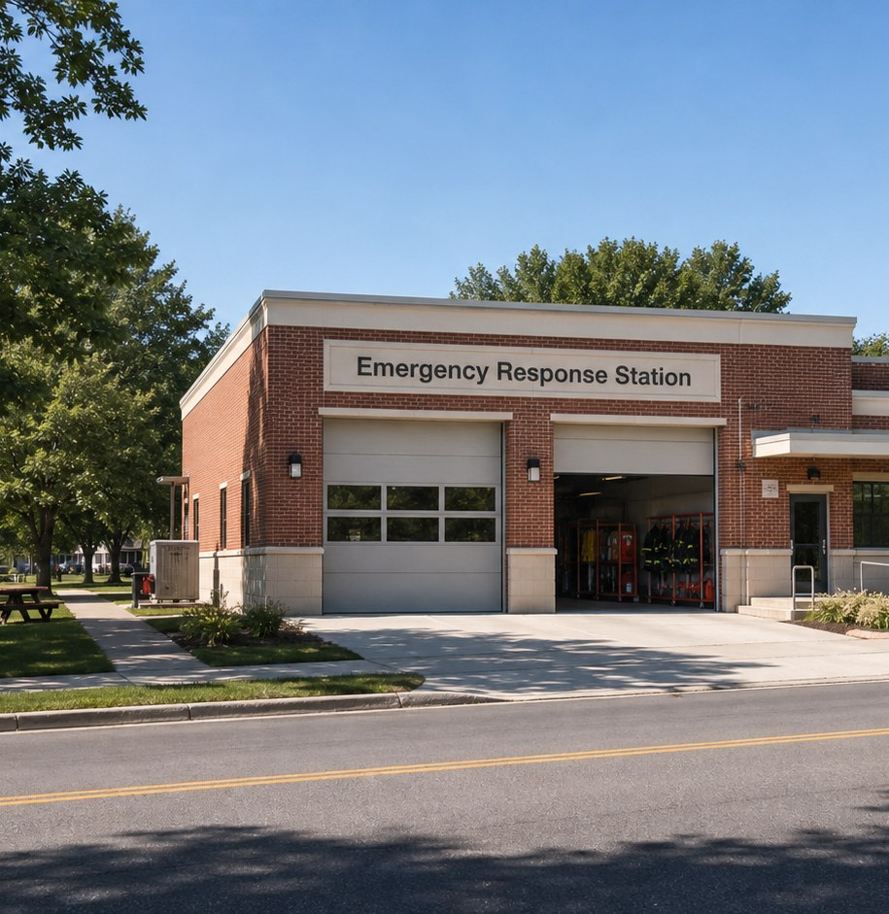
Recap, then the case
One call connects many workers.
At a job fair, an adult says, "I feel dizzy. My chest feels tight."
First: one question from the training week.
CareTown · Module 7 · Emergency Response Station · Unit 3
20

Slide 21
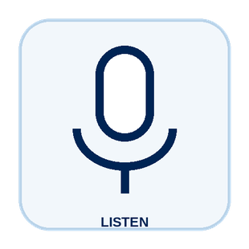
Activity
E3.1 Podcast Keyword Catcher
15 min
Listen, then share
Workbook p. 191
1
Listen or follow the transcript.
2
Record four keywords.
3
Choose one word and explain it.
Done when: Four keywords and one explanation are written.
CareTown · Module 7 · Emergency Response Station · Unit 3
21

Slide 22

Activity
E3.2 Marcus's Response Chain
14 min
Class vote or pairs
Workbook p. 192
1
Read each fictional moment.
2
Choose what protects the chain.
3
Give a reason for each choice.
Done when: Every choice has an answer and a reason.
CareTown · Module 7 · Emergency Response Station · Unit 3
22

Slide 23
Safe communication pattern
Exact words beat a guessed cause.
Context
Facts
Need
Where are we, and what is happening?
What exact words were shared?
What must the next team know?
CareTown · Module 7 · Emergency Response Station · Unit 3
23

Slide 24
Activity
E3.3 Information Handoff Huddle
14 min
Solo, then compare
Workbook p. 195
1
Name the place and what happened.
2
Use exact words or details.
3
Name what the next team needs.
Done when: Your handoff names context, facts, and a need.
CareTown · Module 7 · Emergency Response Station · Unit 3
24

Slide 25
Check for understanding
Which handoff line is strongest?
1
"He is having a heart attack."
2
"Something is wrong."
3
"He said: I feel dizzy."
Show 1, 2, or 3 fingers. Then explain why.
CareTown · Module 7 · Emergency Response Station · Unit 3
25

Slide 26
Unit 3 exit ticket
Before you go
5 min
Workbook p. 204
1
One exact fact an EMT must get right.
2
The person or role who should receive that fact.
CareTown · Module 7 · Emergency Response Station · Unit 3
26

Slide 27
Unit 4 of 4 · 50-minute class period
3 min
Recap: one clue
Emergency Response Fit Check and Next Steps
15 min
E4.1 Strengths and Fit Check
10 min
E4.2 Practical Factor Check
17 min
E4.3 Career Passport and Next-Step Planner
5 min
Exit ticket
CareTown · Module 7 · Emergency Response Station · Unit 4
27

Slide 28
Recap: name one clue from this stop
Meaningful does not mean easy.
Why people choose it
What can be hard
Helpful information
Extended shifts
Skilled teamwork
Lifting and weather
Human support
Hard calls
CareTown · Module 7 · Emergency Response Station · Unit 4
28

Slide 29

Activity
E4.1 Emergency Response Strengths and Fit Check
15 min
Individual · share optional
Workbook p. 197
1
Check strengths that fit.
2
Name one skill to build.
3
Choose yes, maybe, or not right now.
Done when: Three strengths, two lines, and a reasoned fit answer.
CareTown · Module 7 · Emergency Response Station · Unit 4
29

Slide 30
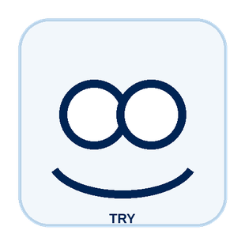
Activity
E4.2 Practical Factor Check
10 min
Individual · may stay private
Workbook p. 199
1
Mark every practical factor.
2
Name one factor to learn about.
3
Name one person or place to ask.
Done when: Every row is marked; one factor and one source are named.
CareTown · Module 7 · Emergency Response Station · Unit 4
30

Slide 31

Activity
E4.3 Career Passport and Next-Step Planner
17 min
Individual writing
Workbook p. 201
1
Write one fact to verify.
2
Choose one next step.
3
Name one trusted person or source.
Done when: One fact, one next step, and one source are written.
CareTown · Module 7 · Emergency Response Station · Unit 4
31

Slide 32
Unit 4 exit ticket
Before you go
5 min
Workbook p. 204
1
One action I will take next, and how it connects to my E4.1 fit answer.
2
One trusted source I will use.
CareTown · Module 7 · Emergency Response Station · Unit 4
32

Slide 33
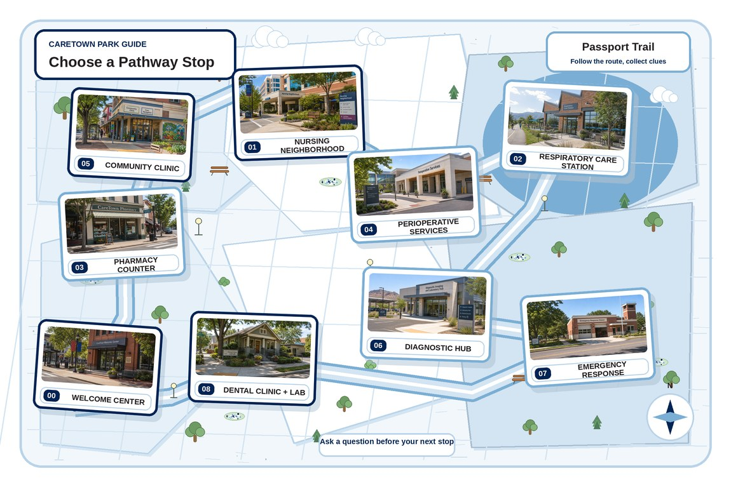
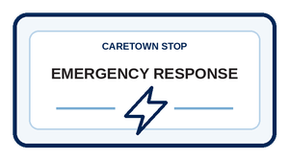
Next stop
Fast work needs a clear chain.
Keep exploring Emergency Response, compare it with another stop, or choose a new one.
CareTown · Module 7 · Emergency Response Station · Unit 4
33

