Slide 1
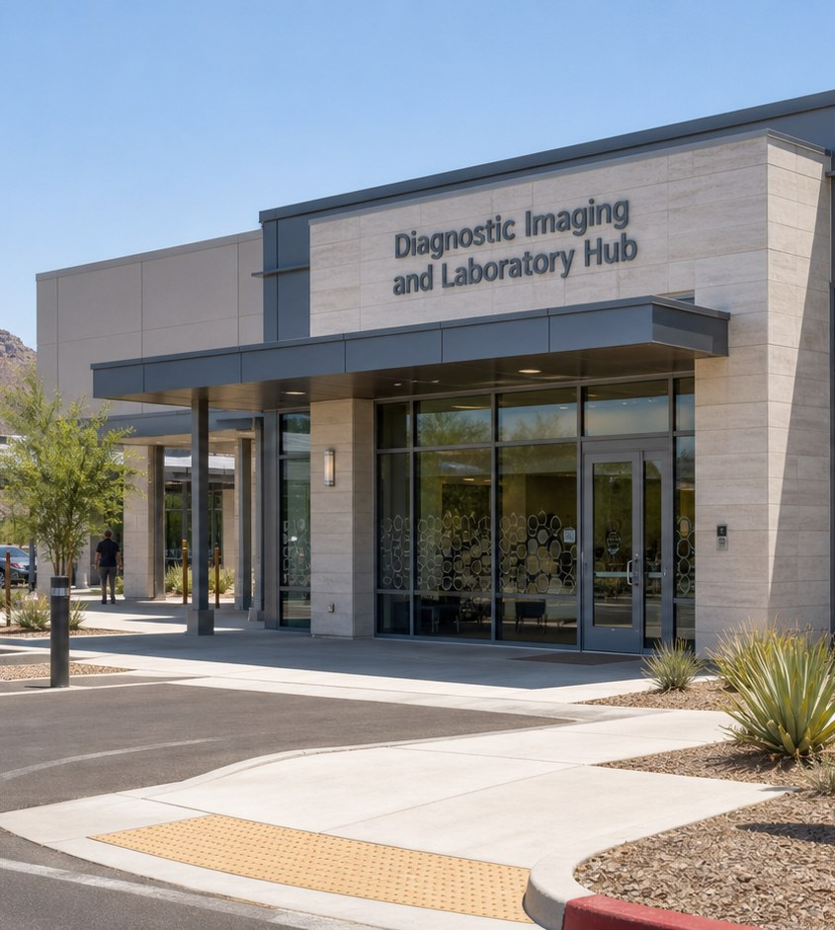
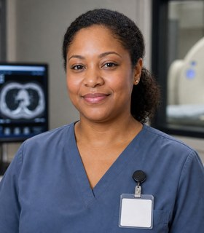

Module 6 · Diagnostic Services Pathway
Diagnostic Hub
Four class periods: the team, training, the workweek, and fit.
Talia + Elijah
01

Slide 2
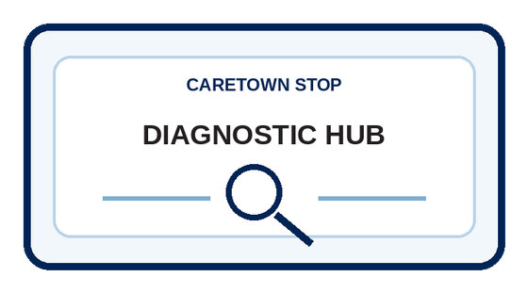
Stop question
What has to stay accurate before a result reaches the care team?
Collect clues in every unit. We answer it together in Unit 4.
CareTown · Module 6 · Diagnostic Hub
02

Slide 3
Stop agenda
Four class periods. One stop.
Period 1
Period 2
Period 3
Period 4
Meet the team
Training week
The workweek
Fit and next steps
H1.1
Exit ticket
H2.1
Exit ticket
H3.1
H3.2
H3.3
Exit ticket
H4.1
H4.2
H4.3
Exit ticket
CareTown · Module 6 · Diagnostic Hub
03

Slide 4
Unit 1 of 4 · 50-minute class period
5 min
Meet Talia and Elijah
Enter Diagnostic Services
15 min
Guide cards, snapshot, quick guide
25 min
H1.1 Role and Modality Map
5 min
Exit ticket
CareTown · Module 6 · Diagnostic Hub · Unit 1
04

Slide 5

Opener · about 5 minutes
Meet Talia and Elijah
Start on the Diagnostic Hub webpage.
As you meet them
One thing Talia does. One question Elijah has.
CareTown · Module 6 · Diagnostic Hub · Unit 1
05

Slide 6
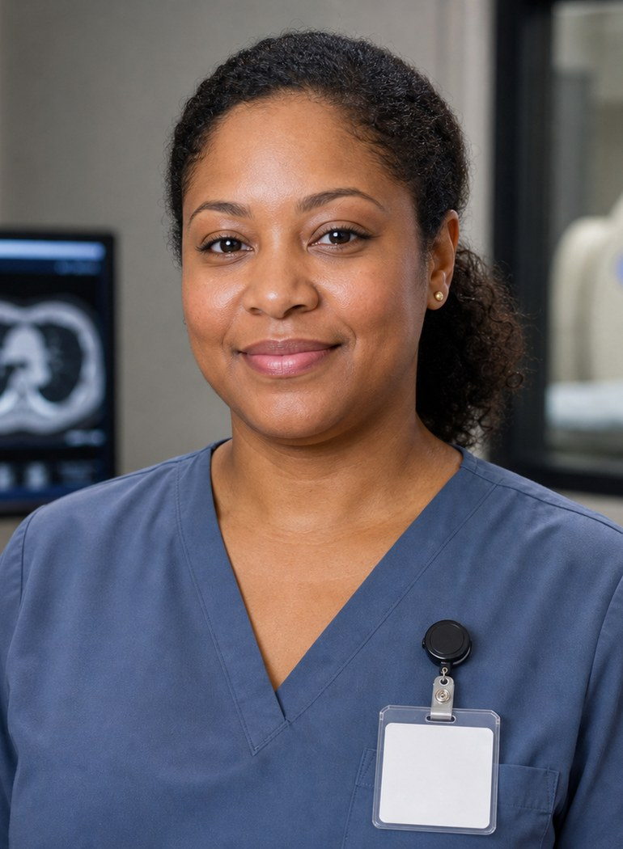
Meet the professional guide
Meet Talia Brooks.
Radiologic technologist
I compare the request with the patient.
I pause when a detail does not match.
I explain the process in plain language.
CareTown · Module 6 · Diagnostic Hub · Unit 1
06

Slide 7
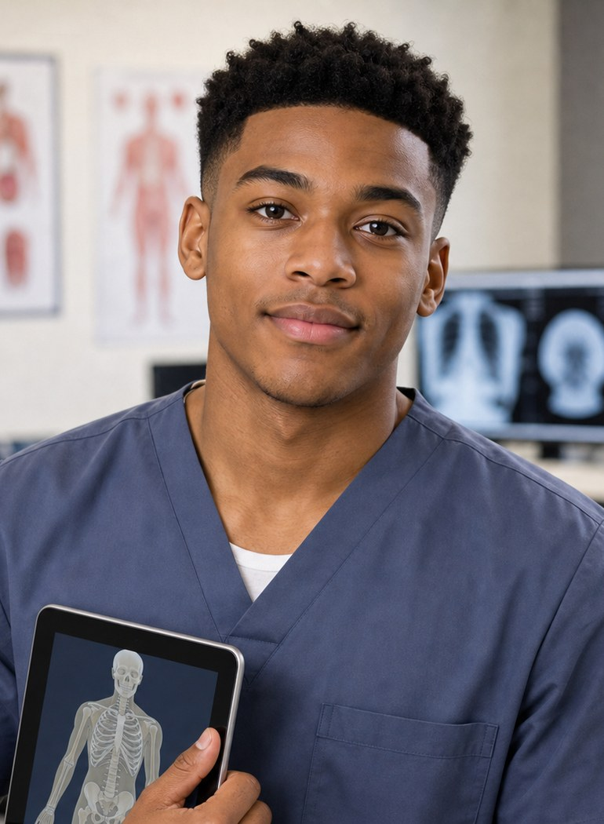
Meet the student explorer
Meet Elijah Carter.
Diagnostic services student
What does each diagnostic role do?
What do I do with an unclear answer?
Could this fit my life right now?
CareTown · Module 6 · Diagnostic Hub · Unit 1
07

Slide 8
Pathway snapshot
Radiologic technologists and technicians at a glance
What they do
Where they work
Median pay
Job growth
Perform diagnostic imaging exams
Hospitals, physicians' offices, labs
$80,110
5%
U.S., May 2025
2025-35, faster than average
Source: U.S. Bureau of Labor Statistics, Occupational Outlook Handbook, Radiologic and MRI Technologists, www.bls.gov/ooh/healthcare/radiologic-technologists.htm (accessed Oct 9, 2026).
CareTown · Module 6 · Diagnostic Hub · Unit 1
08

Slide 9
Roles quick guide
Diagnostic work is many jobs.
Radiologic technologist
Other imaging paths
Laboratory roles
Creates images safely. A radiologist interprets them.
Sonography, MRI, and nuclear medicine have their own routes.
Receive, label, prepare, or test specimens by role.
CareTown characters are fictional. The job titles are real.
CareTown · Module 6 · Diagnostic Hub · Unit 1
09

Slide 10

Activity
H1.1 Role and Modality Map
25 min
Solo, pairs, or groups
Workbook p. 164
1
Sort each role card into an area.
2
Add one credential question.
3
Unsure? Mark the card to check.
Done when: Every role is sorted and one question is written.
CareTown · Module 6 · Diagnostic Hub · Unit 1
10

Slide 11
Check for understanding
Who interprets a diagnostic image?
1
Radiologic technologist
2
Front desk
3
Radiologist or clinician
Show 1, 2, or 3 fingers. Then explain why.
CareTown · Module 6 · Diagnostic Hub · Unit 1
11

Slide 12
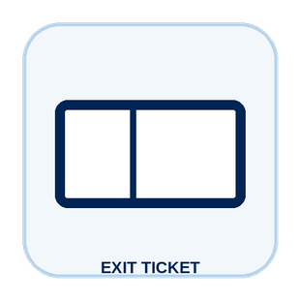
Unit 1 exit ticket
Before you go
5 min
Workbook p. 178
1
Two roles I learned about in this unit.
2
One task or piece of information that moves between them.
CareTown · Module 6 · Diagnostic Hub · Unit 1
12

Slide 13
Unit 2 of 4 · 50-minute class period
5 min
Recap: one role from Unit 1
Week in the Life of a Diagnostic Services Student
10 min
Training route and sample week
30 min
H2.1 Build Elijah's Week
5 min
Exit ticket
CareTown · Module 6 · Diagnostic Hub · Unit 2
13

Slide 14

Recap
Name one role from Unit 1.
Today: Elijah's training week.
Say the role and one thing it does.
CareTown · Module 6 · Diagnostic Hub · Unit 2
14

Slide 15
Training route and sample week
A sample week needs more than class time.
Mon
Tue
Wed
Thu
Fri
Sun
anatomy
practice
physics
clinical learning
clinical learning
study
Example only. Ask each program for its current schedule.
CareTown · Module 6 · Diagnostic Hub · Unit 2
15

Slide 16
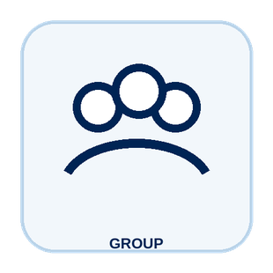
Activity
H2.1 Build Elijah's Week
30 min
Solo, pairs, or groups
Workbook p. 165
1
Place class and clinical learning first.
2
Add travel, food, study, and rest.
3
Mark one pressure point and one support.
Done when: Your week shows one pressure point and one support.
CareTown · Module 6 · Diagnostic Hub · Unit 2
16

Slide 17
Check for understanding
What does Elijah's week include besides class?
1
Clinical learning, study, travel, rest
2
Nothing else
3
Only physics
Show 1, 2, or 3 fingers. Then explain why.
CareTown · Module 6 · Diagnostic Hub · Unit 2
17

Slide 18
Unit 2 exit ticket
Before you go
5 min
Workbook p. 178
1
One question I would ask an imaging or laboratory program before applying.
2
One support that could help a student in this training.
CareTown · Module 6 · Diagnostic Hub · Unit 2
18

Slide 19
Unit 3 of 4 · 50-minute class period
2 min
Recap: one week question
Week in the Life of Diagnostic Services Work
15 min
H3.1 Podcast Keyword Catcher
14 min
H3.2 Talia's Diagnostic Workflow
14 min
H3.3 Accuracy Chain Huddle
5 min
Exit ticket
CareTown · Module 6 · Diagnostic Hub · Unit 3
19

Slide 20
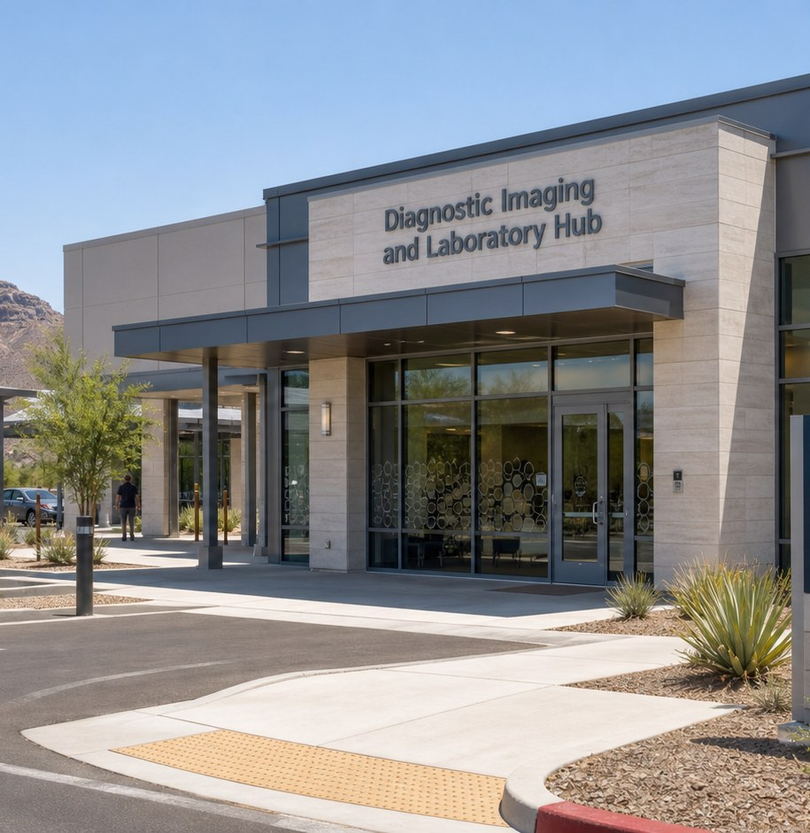
Recap, then the case
One detail does not match.
Talia compares the request with the patient information. One detail is different.
First: one question from the training week.
CareTown · Module 6 · Diagnostic Hub · Unit 3
20

Slide 21

Activity
H3.1 Podcast Keyword Catcher
15 min
Listen as a class
Workbook p. 167
1
Listen or read along.
2
Write three to five keywords.
3
Write one question to verify.
Done when: Three keywords, one idea, and one question are written.
CareTown · Module 6 · Diagnostic Hub · Unit 3
21

Slide 22

Activity
H3.2 Talia's Diagnostic Workflow
14 min
Class vote or pairs
Workbook p. 168
1
Read each fictional moment.
2
Choose the strongest next move.
3
Name what Talia protects.
Done when: Every choice has an answer and a reason.
CareTown · Module 6 · Diagnostic Hub · Unit 3
22

Slide 23
Safe communication pattern
Pause before the work moves.
Match
Pause
Hand off
Compare the request with confirmed identity.
Stop when one detail does not match.
Name exactly what is different.
CareTown · Module 6 · Diagnostic Hub · Unit 3
23

Slide 24
Activity
H3.3 Accuracy Chain Huddle
14 min
Solo, then compare
Workbook p. 171
1
Check request and identity.
2
Note labels, privacy, and screening.
3
Name the handoff and receiver.
Done when: All four links are clear and name a receiver.
CareTown · Module 6 · Diagnostic Hub · Unit 3
24

Slide 25
Check for understanding
A request detail does not match the patient. Talia's move?
1
Fix it from memory
2
Pause and hand off the difference
3
Image anyway
Show 1, 2, or 3 fingers. Then explain why.
CareTown · Module 6 · Diagnostic Hub · Unit 3
25

Slide 26
Unit 3 exit ticket
Before you go
5 min
Workbook p. 179
1
One exact fact a diagnostic services worker must get right.
2
The person or role who should receive that fact.
CareTown · Module 6 · Diagnostic Hub · Unit 3
26

Slide 27
Unit 4 of 4 · 50-minute class period
3 min
Recap: one clue
Diagnostic Services Fit Check
15 min
H4.1 Strengths and Fit Check
10 min
H4.2 Practical Factor Check
17 min
H4.3 Career Passport and Next-Step Planner
5 min
Exit ticket
CareTown · Module 6 · Diagnostic Hub · Unit 4
27

Slide 28
Recap: name one clue from this stop
Meaningful does not mean easy.
Why people choose it
What can be hard
Calmer patients
Repeated precise checks
Useful information
Physical positioning
Science and tools
Urgent or late shifts
CareTown · Module 6 · Diagnostic Hub · Unit 4
28

Slide 29

Activity
H4.1 Diagnostic Services Strengths and Fit Check
15 min
Individual · share optional
Workbook p. 173
1
Check strengths that fit.
2
Name one skill to build.
3
Choose yes, maybe, or not right now.
Done when: Three strengths, two lines, and a reasoned fit answer.
CareTown · Module 6 · Diagnostic Hub · Unit 4
29

Slide 30
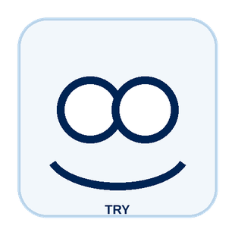
Activity
H4.2 Practical Factor Check
10 min
Individual · may stay private
Workbook p. 174
1
Mark every practical factor.
2
Name one factor to learn about.
3
Name one person or place to ask.
Done when: Every row is marked; one factor and one source are named.
CareTown · Module 6 · Diagnostic Hub · Unit 4
30

Slide 31

Activity
H4.3 Career Passport and Next-Step Planner
17 min
Individual writing
Workbook p. 176
1
Write one fact to verify.
2
Choose one next step.
3
Name one trusted person or source.
Done when: One fact, one next step, and one source are written.
CareTown · Module 6 · Diagnostic Hub · Unit 4
31

Slide 32
Unit 4 exit ticket
Before you go
5 min
Workbook p. 179
1
One action I will take next, and how it connects to my H4.1 fit answer.
2
One trusted source I will use.
CareTown · Module 6 · Diagnostic Hub · Unit 4
32

Slide 33
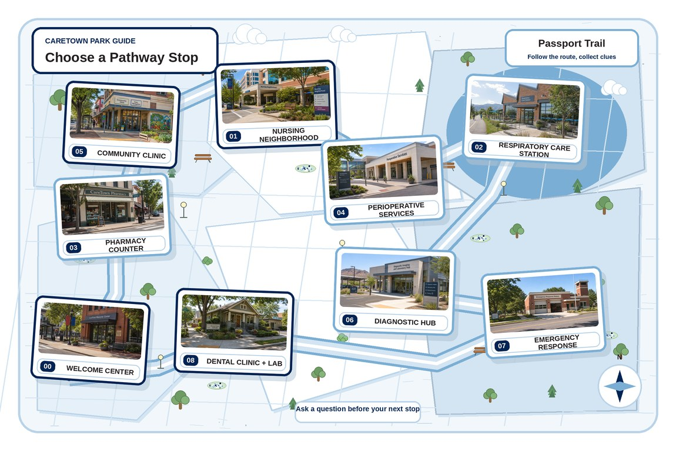
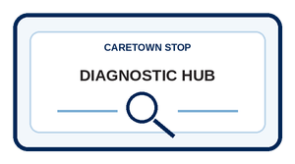
Next stop
Every result starts with an accurate chain.
Keep exploring Diagnostic Services, compare it with another stop, or choose a new one.
CareTown · Module 6 · Diagnostic Hub · Unit 4
33

