Slide 1
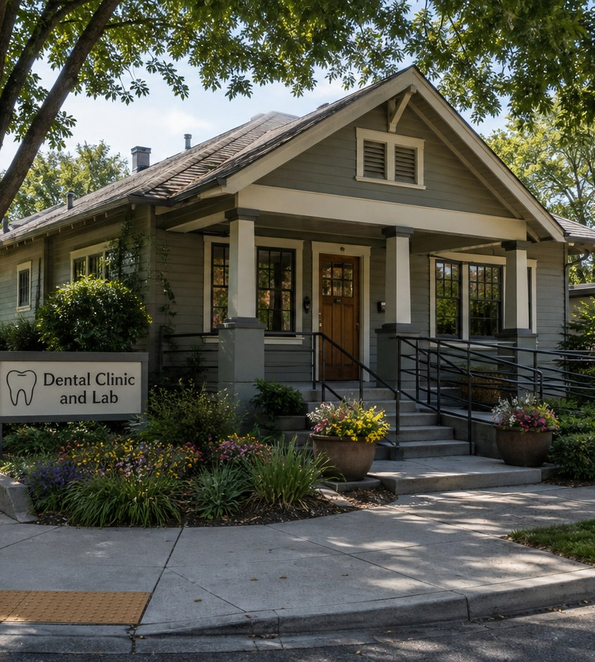
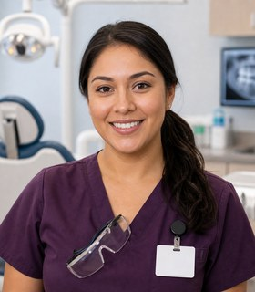
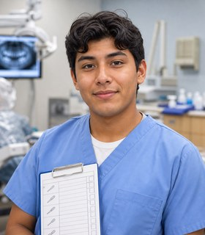
Module 8 · Dental Health Technology Pathway
Dental Clinic and Lab
Four class periods: the team, training, the workweek, and fit.
Marisol + Nico
01

Slide 2
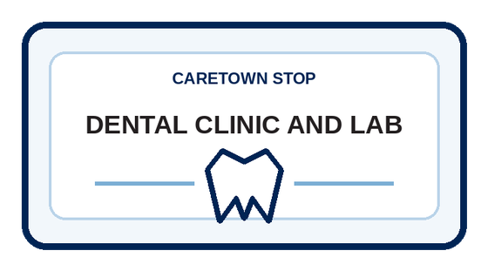
Stop question
What happens before the chair that helps a patient feel safe?
Collect clues in every unit. We answer it together in Unit 4.
CareTown · Module 8 · Dental Clinic and Lab
02

Slide 3
Stop agenda
Four class periods. One stop.
Period 1
Period 2
Period 3
Period 4
Meet the team
Training week
The workweek
Fit and next steps
D1.1
Exit ticket
D2.1
Exit ticket
D3.1
D3.2
D3.3
Exit ticket
D4.1
D4.2
D4.3
Exit ticket
CareTown · Module 8 · Dental Clinic and Lab
03

Slide 4
Unit 1 of 4 · 50-minute class period
5 min
Meet Marisol and Nico
Enter Dental Health Technology
15 min
Guide cards, snapshot, quick guide
25 min
D1.1 Dental Team and Workflow Map
5 min
Exit ticket
CareTown · Module 8 · Dental Clinic and Lab · Unit 1
04

Slide 5

Opener · about 5 minutes
Meet Marisol and Nico
Start on the Dental Clinic and Lab webpage.
As you meet them
One thing Marisol does. One question Nico has.
CareTown · Module 8 · Dental Clinic and Lab · Unit 1
05

Slide 6
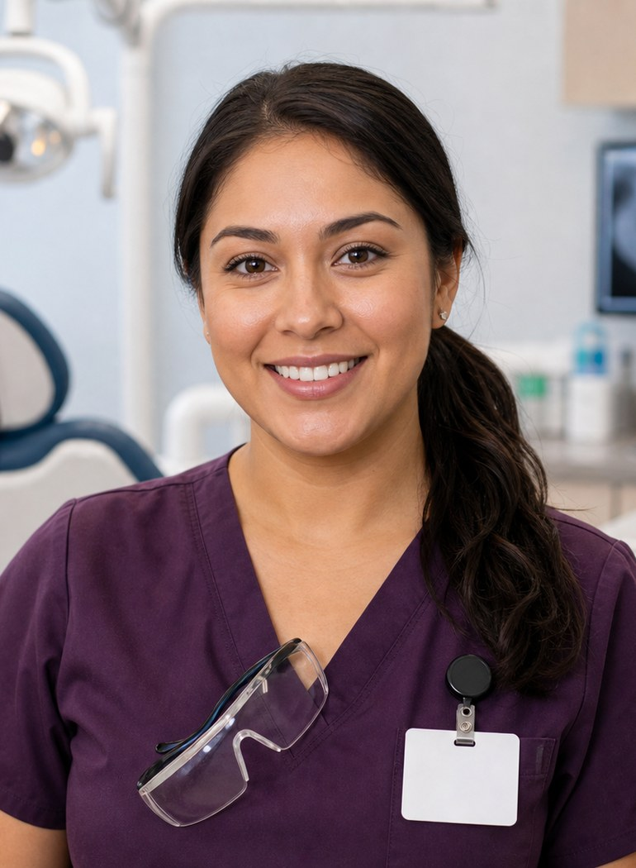
Meet the professional guide
Meet Marisol Vega.
Registered dental assistant
I check the room-readiness list.
I do not guess that an item is ready.
I explain the next step in plain words.
CareTown · Module 8 · Dental Clinic and Lab · Unit 1
06

Slide 7
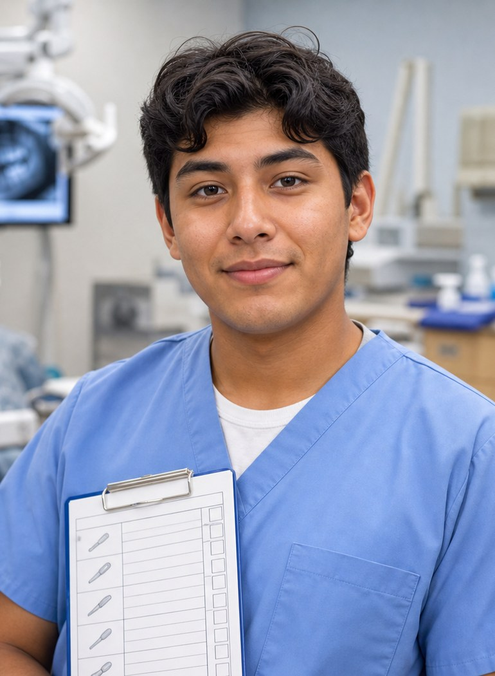
Meet the student explorer
Meet Nico Alvarez.
Dental assisting student
What does each dental role do?
What do I do when I am unsure?
Could this fit my life right now?
CareTown · Module 8 · Dental Clinic and Lab · Unit 1
07

Slide 8
Pathway snapshot
Dental assistants at a glance
What they do
Where they work
Median pay
Job growth
Patient care, x rays, records, and scheduling
Almost all in dentists' offices
$48,070
7%
U.S., May 2025
2025-35, much faster than average
Source: U.S. Bureau of Labor Statistics, Occupational Outlook Handbook, Dental Assistants, www.bls.gov/ooh/healthcare/dental-assistants.htm (accessed Oct 9, 2026).
CareTown · Module 8 · Dental Clinic and Lab · Unit 1
08

Slide 9
Roles quick guide
A dental visit takes a team.
Dental assistant
Registered dental assistant
Dental lab technician
Supports comfort, readiness, and chairside work.
A California license with courses and an exam.
Makes or repairs appliances from work orders.
CareTown characters are fictional. The job titles are real.
CareTown · Module 8 · Dental Clinic and Lab · Unit 1
09

Slide 10

Activity
D1.1 Dental Team and Workflow Map
25 min
Solo, pairs, or groups
Workbook p. 210
1
Place at least four roles.
2
Add one prep and one communication task.
3
Add a lab link and a question.
Done when: Four roles, two tasks, and one question placed.
CareTown · Module 8 · Dental Clinic and Lab · Unit 1
10

Slide 11
Check for understanding
Who makes dental appliances from work orders?
1
Dental assistant
2
Dental lab technician
3
Front desk
Show 1, 2, or 3 fingers. Then explain why.
CareTown · Module 8 · Dental Clinic and Lab · Unit 1
11

Slide 12
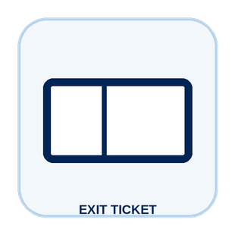
Unit 1 exit ticket
Before you go
5 min
Workbook p. 226
1
Two roles I learned about in this unit.
2
One task or piece of information that moves between them.
CareTown · Module 8 · Dental Clinic and Lab · Unit 1
12

Slide 13
Unit 2 of 4 · 50-minute class period
5 min
Recap: one role from Unit 1
Week in the Life of a Dental Health Student
10 min
Training route and sample week
30 min
D2.1 Build Nico's Student Week
5 min
Exit ticket
CareTown · Module 8 · Dental Clinic and Lab · Unit 2
13

Slide 14
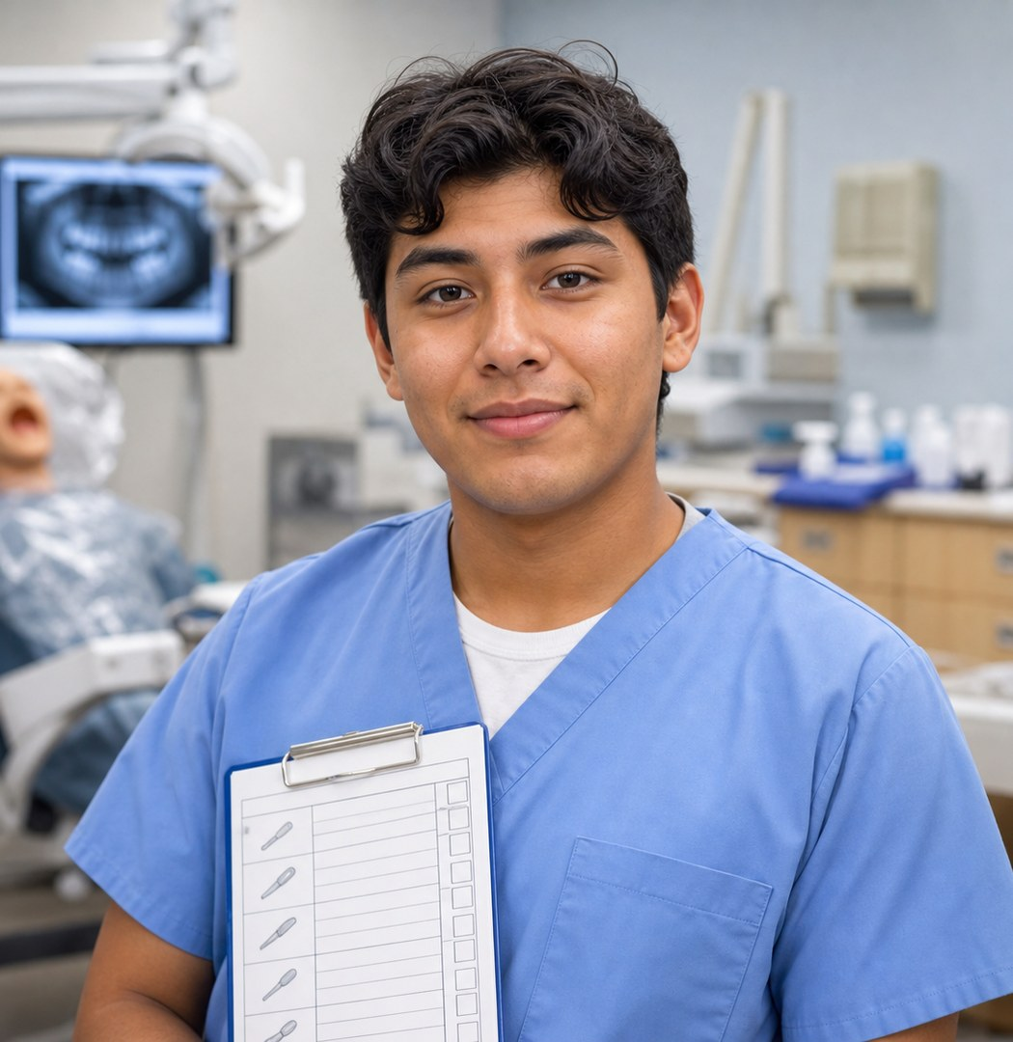
Recap
Name one role from Unit 1.
Today: Nico's training week.
Say the role and one thing it does.
CareTown · Module 8 · Dental Clinic and Lab · Unit 2
14

Slide 15
Training route and sample week
A sample week needs more than class time.
Mon
Tue
Wed
Thu
Fri
Every night
class
lab practice
class
infection control
externship meeting
dental terms
Example only. Ask each program for its current schedule.
CareTown · Module 8 · Dental Clinic and Lab · Unit 2
15

Slide 16
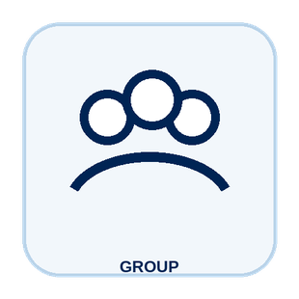
Activity
D2.1 Build Nico's Student Week
30 min
Solo, pairs, or groups
Workbook p. 212
1
Place class, lab, and infection control.
2
Add travel, life needs, study, and rest.
3
Mark one support and one question.
Done when: Your week shows one support and one program question.
CareTown · Module 8 · Dental Clinic and Lab · Unit 2
16

Slide 17
Check for understanding
What does Nico's week need besides class?
1
Nothing else
2
Only the externship
3
Lab, infection control, study, rest
Show 1, 2, or 3 fingers. Then explain why.
CareTown · Module 8 · Dental Clinic and Lab · Unit 2
17

Slide 18
Unit 2 exit ticket
Before you go
5 min
Workbook p. 226
1
One question I would ask a dental assisting program before applying.
2
One support that could help a student in this training.
CareTown · Module 8 · Dental Clinic and Lab · Unit 2
18

Slide 19
Unit 3 of 4 · 50-minute class period
2 min
Recap: one week question
Week in the Life of Dental Health Work
15 min
D3.1 Podcast Keyword Catcher
14 min
D3.2 Marisol's Ready Room
14 min
D3.3 Patient-Trust Workflow Board
5 min
Exit ticket
CareTown · Module 8 · Dental Clinic and Lab · Unit 3
19

Slide 20
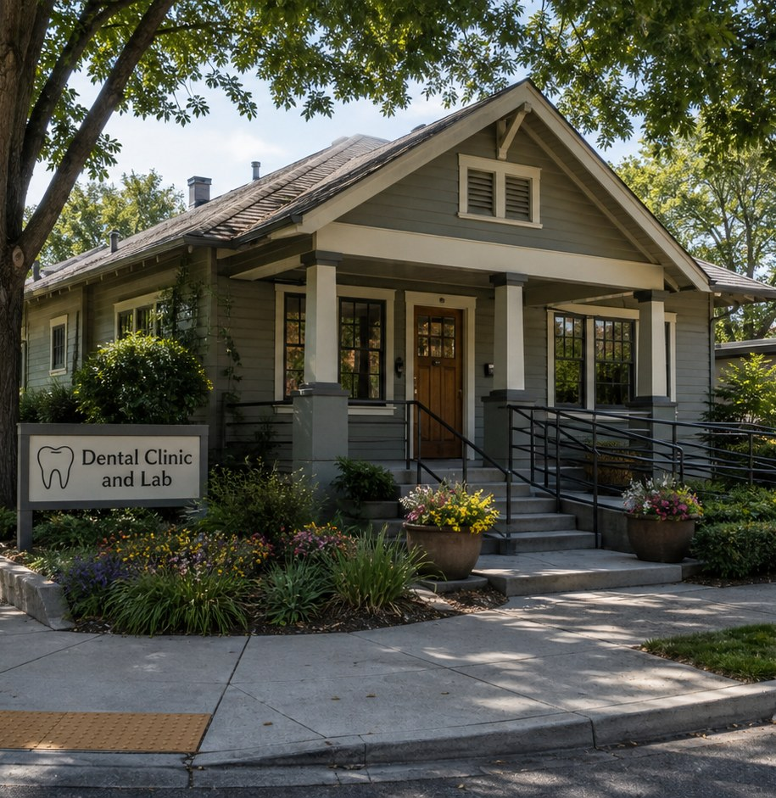
Recap, then the case
The patient is nervous.
The room is almost ready. The patient says, "I do not know what happens next."
First: one question from the training week.
CareTown · Module 8 · Dental Clinic and Lab · Unit 3
20

Slide 21
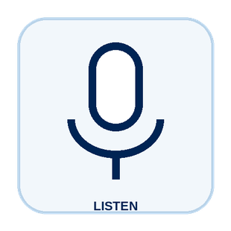
Activity
D3.1 Podcast Keyword Catcher
15 min
Listen as a class
Workbook p. 214
1
Listen or read along.
2
Write three to five keywords.
3
Write one idea you are curious about.
Done when: Three keywords, one idea, and one question are written.
CareTown · Module 8 · Dental Clinic and Lab · Unit 3
21

Slide 22

Activity
D3.2 Marisol's Ready Room
14 min
Class vote or pairs
Workbook p. 215
1
Read each fictional moment.
2
Choose the strongest next move.
3
Name what Marisol or Nico protects.
Done when: Every choice has an answer and a reason.
CareTown · Module 8 · Dental Clinic and Lab · Unit 3
22

Slide 23
Safe communication pattern
Say what you know. Ask about the rest.
Check
Notice
Communicate
An item with no status stays open.
Report the exact observation.
Explain the next step; connect questions.
CareTown · Module 8 · Dental Clinic and Lab · Unit 3
23

Slide 24
Activity
D3.3 Patient-Trust Workflow Board
14 min
Solo, then compare
Workbook p. 218
1
Name the context and what you noticed.
2
Write one welcoming sentence.
3
Name who should answer or act.
Done when: All four parts are clear and name who acts.
CareTown · Module 8 · Dental Clinic and Lab · Unit 3
24

Slide 25
Check for understanding
The schedule is running late. Nico's best move?
1
Say what he knows; ask for an update
2
Invent a time
3
Say nothing
Show 1, 2, or 3 fingers. Then explain why.
CareTown · Module 8 · Dental Clinic and Lab · Unit 3
25

Slide 26
Unit 3 exit ticket
Before you go
5 min
Workbook p. 227
1
One exact fact a dental assistant must get right.
2
The person or role who should receive that fact.
CareTown · Module 8 · Dental Clinic and Lab · Unit 3
26

Slide 27
Unit 4 of 4 · 50-minute class period
3 min
Recap: one clue
Dental Health Technology Fit Check
15 min
D4.1 Strengths and Fit Check
10 min
D4.2 Practical Factor Check
17 min
D4.3 Career Passport and Next-Step Planner
5 min
Exit ticket
CareTown · Module 8 · Dental Clinic and Lab · Unit 4
27

Slide 28
Recap: name one clue from this stop
Meaningful does not mean easy.
Why people choose it
What can be hard
Patient trust
Close patient contact
Ready rooms
Fine hand skills
Team rhythm
Standing and time pressure
CareTown · Module 8 · Dental Clinic and Lab · Unit 4
28

Slide 29

Activity
D4.1 Dental Health Technology Strengths and Fit Check
15 min
Individual · share optional
Workbook p. 221
1
Check strengths that fit.
2
Name one skill to build.
3
Choose yes, maybe, or not right now.
Done when: Three strengths, two lines, and a reasoned fit answer.
CareTown · Module 8 · Dental Clinic and Lab · Unit 4
29

Slide 30
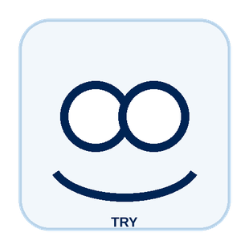
Activity
D4.2 Practical Factor Check
10 min
Individual · may stay private
Workbook p. 222
1
Mark every practical factor.
2
Name one factor to learn about.
3
Name one person or place to ask.
Done when: Every row is marked; one factor and one source are named.
CareTown · Module 8 · Dental Clinic and Lab · Unit 4
30

Slide 31

Activity
D4.3 Career Passport and Next-Step Planner
17 min
Individual writing
Workbook p. 224
1
Write one fact to verify.
2
Choose one next step.
3
Name one trusted person or source.
Done when: One fact, one next step, and one source are written.
CareTown · Module 8 · Dental Clinic and Lab · Unit 4
31

Slide 32
Unit 4 exit ticket
Before you go
5 min
Workbook p. 227
1
One action I will take next, and how it connects to my D4.1 fit answer.
2
One trusted source I will use.
CareTown · Module 8 · Dental Clinic and Lab · Unit 4
32

Slide 33
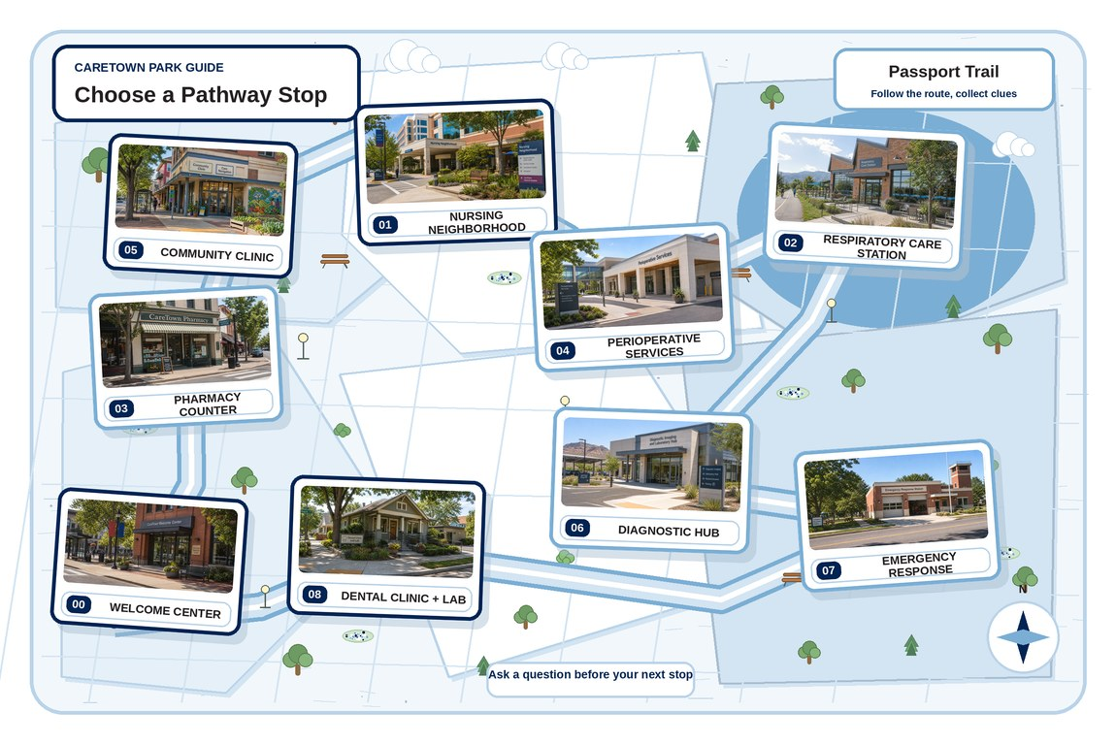
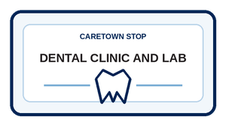
Next stop
Trust is built before the chair.
Keep exploring Dental Health Technology, compare it with another stop, or choose a new one.
CareTown · Module 8 · Dental Clinic and Lab · Unit 4
33

